Slide 1

Leveraging Sales Performance: Customer Segmentation Analysis for RevoBank's Credit Cards
PRESENTED BY LIDIA PUSPA N

Slide 2

Business Background
Today's date is May 31, 2023, and you're a data analyst at RevoBank, a bank based in Europe. You're currently working with the Performance Management (PM) team, whose goal is to encourage existing customers to use RevoBank credit card products more.
You've received a data summary from the MIS (Management Information System) team, detailing clients and their sales over the last three years (36 months). Your manager has tasked you with summarizing the sales performance from the past three years and creating user personas based on the existing clients.

Slide 3





Problem Statement
How to encourage existing customers to use RevoBank credit card products more?

Slide 4
Analyze sales data over the past three years to identify trends, patterns, and overall performance.
Goal of The Analysis
Identify potential gaps or opportunities for encouraging more frequent use of credit cards.
Create customer segmentation based on demographics, behaviors, and purchasing patterns.

Slide 5




Dataset Overview
The dataset contains client sales data from June 1, 2020, to May 31, 2023, covering a total of 12,559 rows and 11 columns. It represents various aspects of user behavior, categorized into:
User information: account_id, MOB, flag_female, birth_date
User classification: account_activity_level, customer_value_level
Behavioral features: avg_sales_L36M, cnt_sales_L36M, last_sales, month_since_last_sales, count_direct_promo_L12M
Dataset Source
This is simulated sales data from RevoU.
Disclaimer
This dataset is a simulated dataset created for educational and analytical purposes. It does not contain real customer data and should not be used for actual business decisions. Any resemblance to real individuals or transactions is purely coincidental.

Slide 6

Data Identification

Slide 7
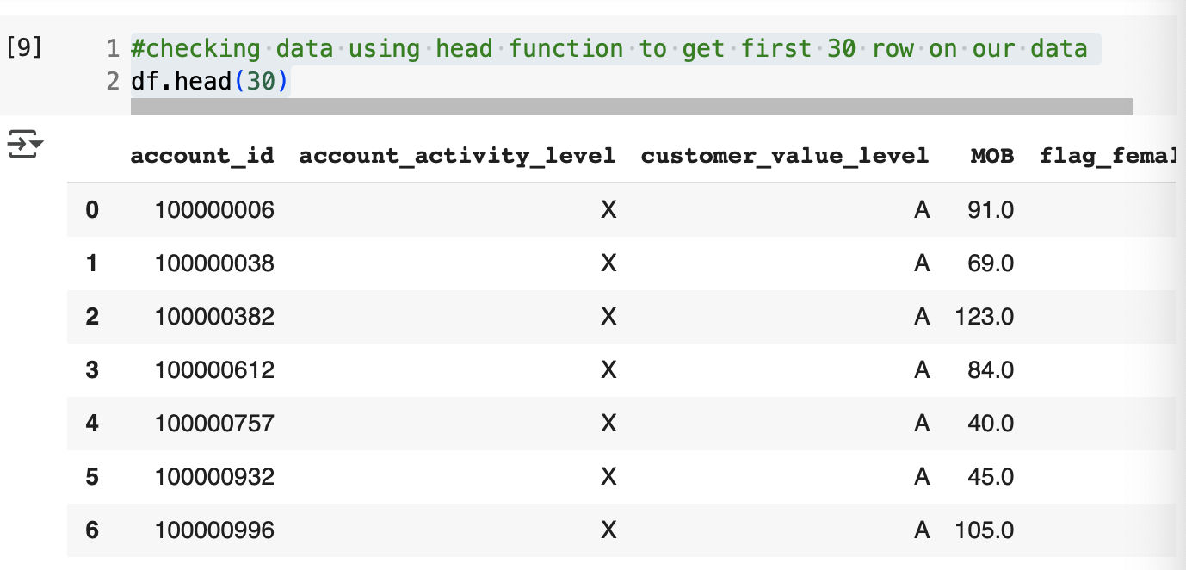
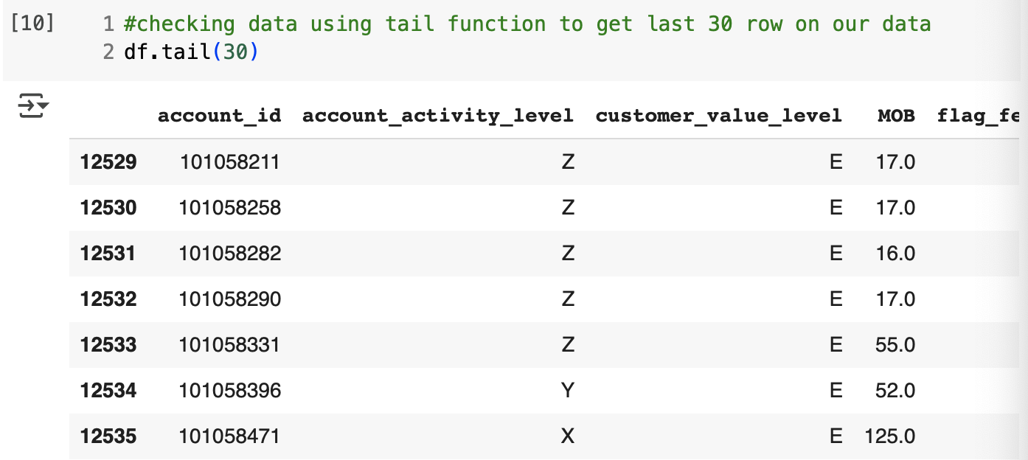
Data Identification(1/5)
1
Initial Inspection
Inspect all the column in the dataset to understand its structure and patterns.
1a
Code
#checking data using head function to get first 30 row on our data
df.head(30)
#checking data using tail function to get last 30 row on our data
df.tail(30)
1b
Findings
MOB (Month on Books) represents the length of time (in months) a customer has been a bank customer, and its values contain decimals.
Missing values in the avg_sales_L36M column are identified by NaN (Not a Number).
More results on Google Colab Notebook

Slide 8
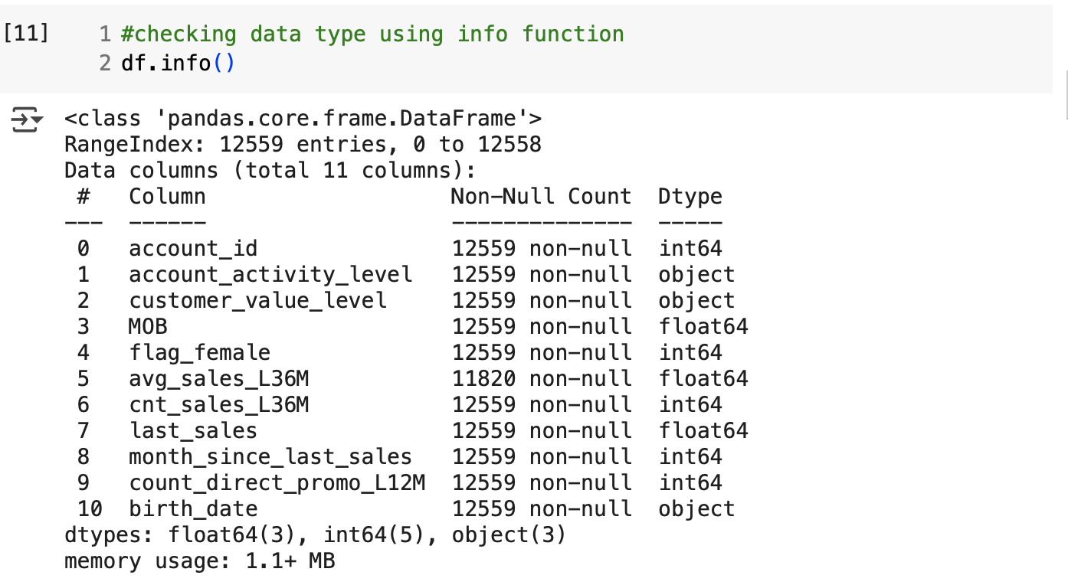
Data Identification(2/5)
2
Checking Data Types
Identified data types for each column to ensure is similar to the data dictionary format
2a
Code
#checking data type using info function
df.info()
2b
Findings
account_id: Currently an integer, should be a string.
MOB: Currently a float, should be an integer, as it represents the duration (in months) a customer has held an account.
birth_date: Currently an object, should be a datetime, as it represents a date.
More results on Google Colab Notebook

Slide 9
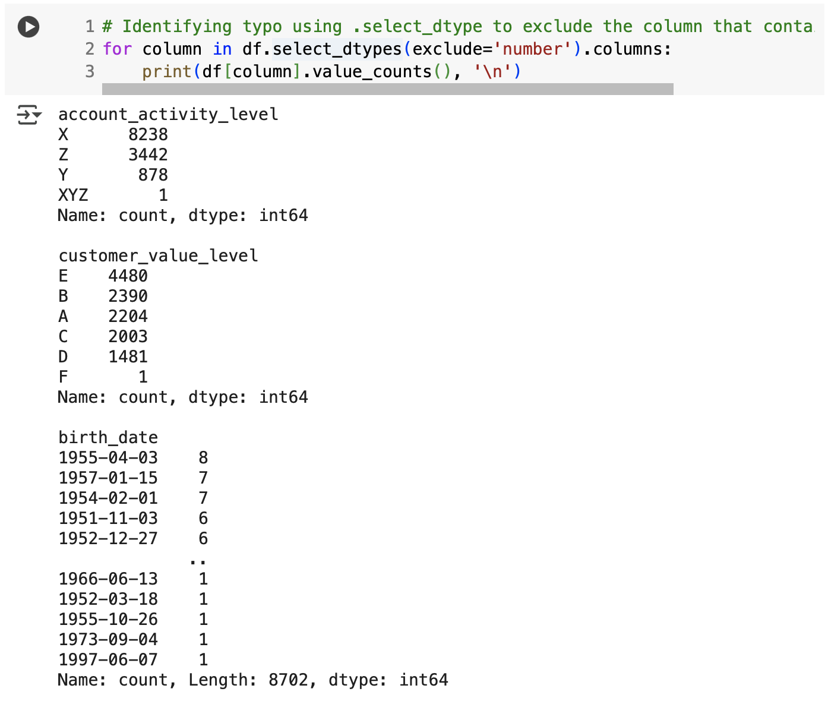
Data Identification(3/5)
3
Checking Typo
Checked for inconsistencies or typographical errors in categorical fields.​
3a
Code
# Identifying typo using .select_dtype to exclude the column that contain numbers
for column in df.select_dtypes(exclude='number').columns:
print(df[column].value_counts(), '\n')
3b
Findings
The account_activity_level column has 4 categories. The 'XYZ' category should be removed.
The customer_value_level column has 6 categories. The 'F' category should be removed.
More results on Google Colab Notebook

Slide 10
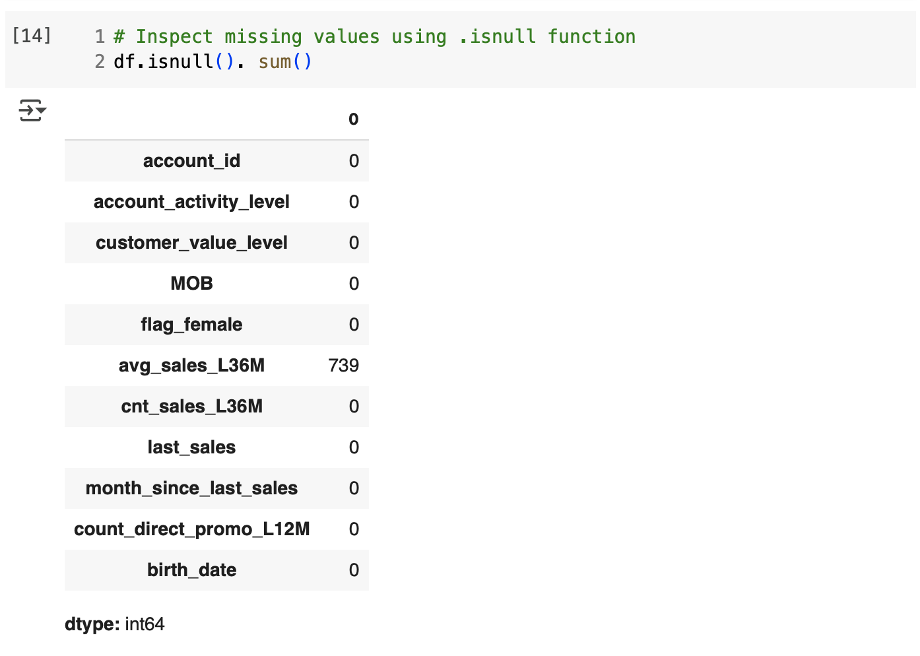
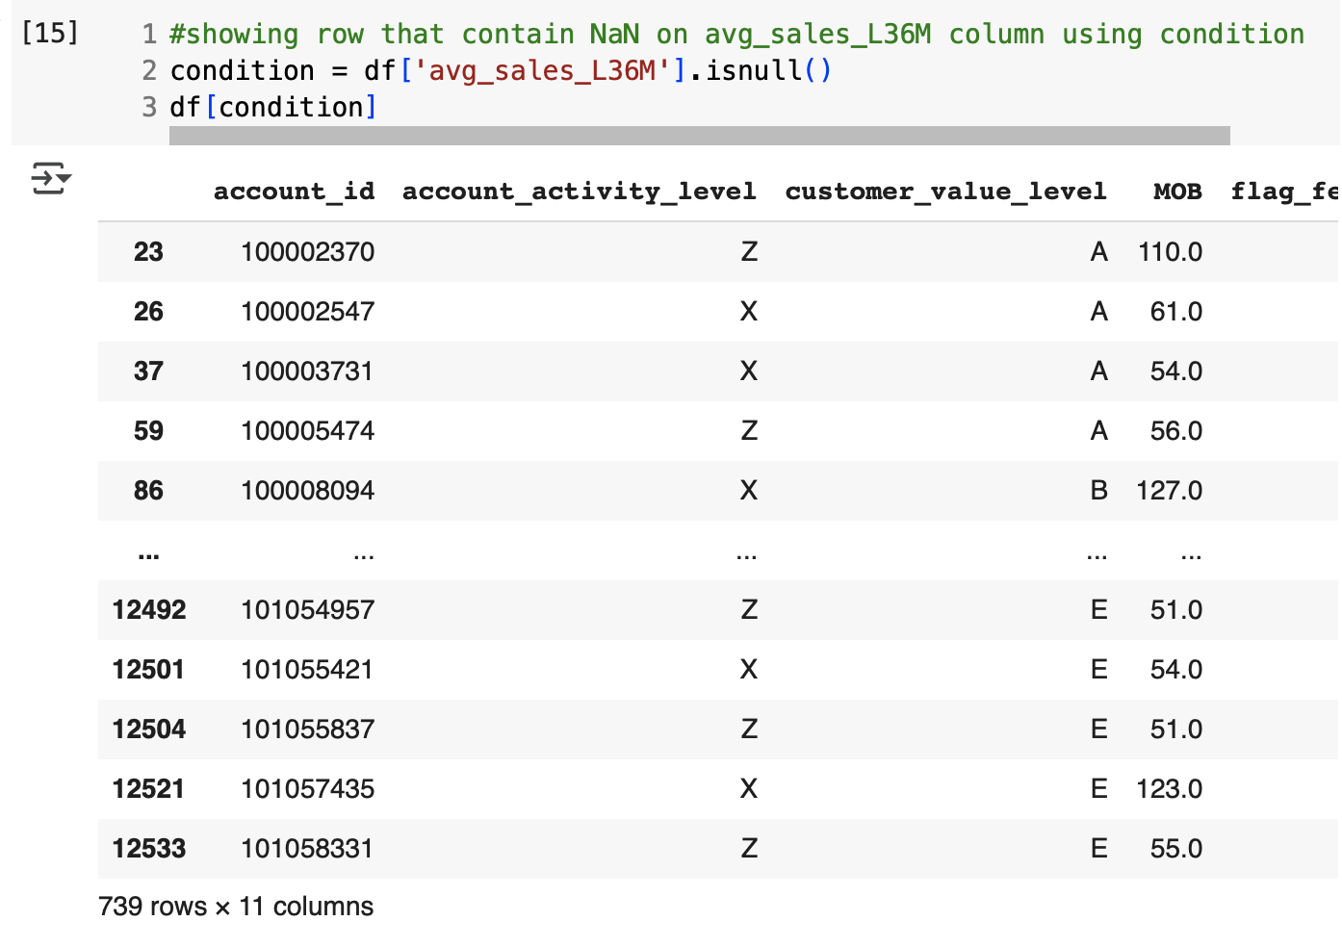
Data Identification(4/5)
4
Identifying Missing Values
Assessed the dataset for any missing values across all columns.​
4a
Code
# Inspect missing values using .isnull function
df.isnull(). sum()
#showing row that contain NaN on avg_sales_L36M column using condition
condition = df['avg_sales_L36M'].isnull()
df[condition]
4b
Findings
In the dataset, whenever avg_sales_L36M is NaN, the corresponding cnt_sales_L36M is 0. This indicates that those accounts had no product purchases in the last 36 months, resulting in an undefined average sales value (NaN). Replacing these NaN values in avg_sales_L36M with 0 will provide a numerical value and simplify calculations. Replacing NaN with 0 gives the average sales which is 0 for customer with no purchase.
More results on Google Colab Notebook

Slide 11
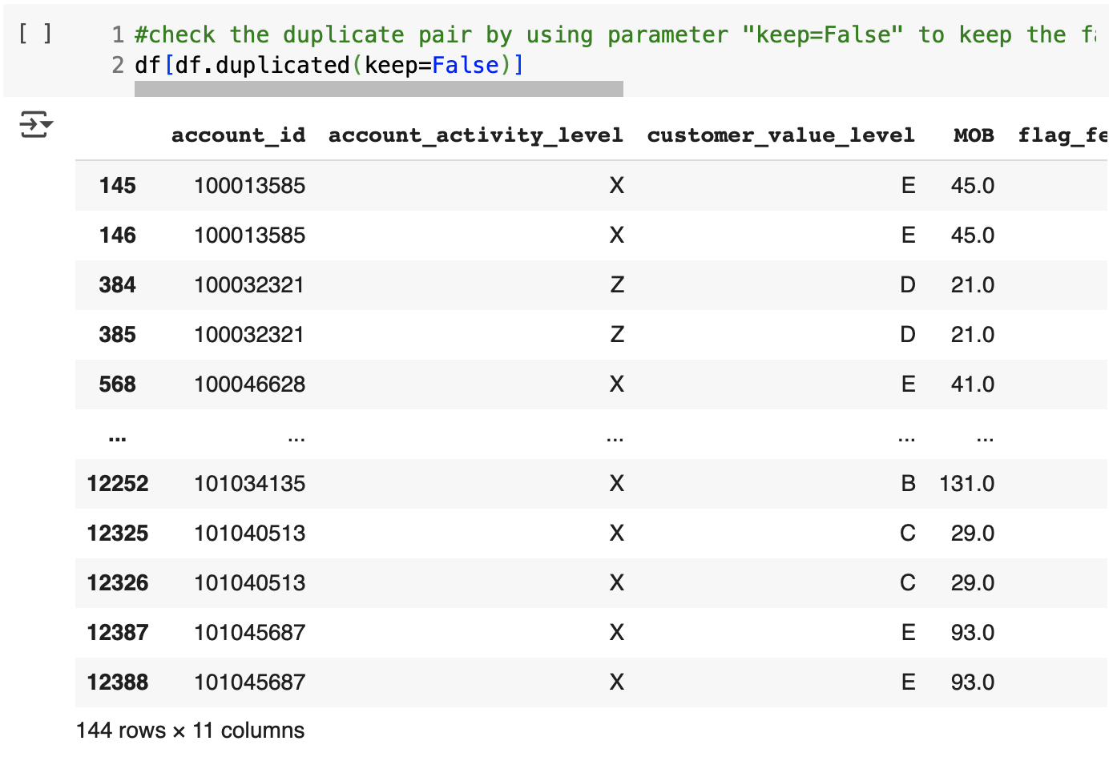
Data Identification(5/5)
4
Identifying Duplicates
Checked for duplicate records that could skew analysis results.​
4a
Code
#check the duplicate pair by using parameter "keep=False" to keep the false (non duplicates row) and show the true (duplicates row)
df[df.duplicated(keep=False)]
#inspect duplicates data using on columns that contain unique values
#'account_id','birth_date'as a parameter columns to lookup to identify the duplicates row
df[df.duplicated(keep=False, subset=['account_id','birth_date'])]
4b
Findings
144 duplicate rows were detected. These should be removed to ensure each customer (account_id) appears only once, as the data summarizes individual sales performance over 36 months.
More results on Google Colab Notebook

Slide 12

Data Identification Findings
Findings |  | Action Plan
Initial Inspection | The dataset needs to be visually examined before further analysis | Conduct an initial exploration to understand the dataset structure, value distributions, and general patterns
Data Type Issues | account_id is stored as int, but it should be str since it is a unique ID and not meant for numerical calculations | Convert account_id to str to prevent it from being misused in numerical operations
 | MOB is stored as float, but it should be int since it represents the number of months a customer has held an account | Convert MOB to int to better align with its contextual meaning
 | birth_date is stored as object, but it should be datetime since it represents a birth date | Convert birth_date to datetime format to allow for accurate age calculations
Typos & Anomalies | account_activity_level contains an invalid category (XYZ) | Remove records with the XYZ category as it is not a valid classification
 | customer_value_level contains an invalid category (F) | Remove records with the F category as it is not a valid classification
Missing Values | avg_sales_L36M had missing values (NaN) | Replacing NaN with 0 ensures numerical consistency and future calculations.
Duplicate Data | Found 144 duplicate rows (72 identical pairs) | Remove duplicates (keeping one from each duplicate pair) to ensure dataset uniqueness
More results on Google Colab Notebook

Slide 13
Data Cleaning

Slide 14
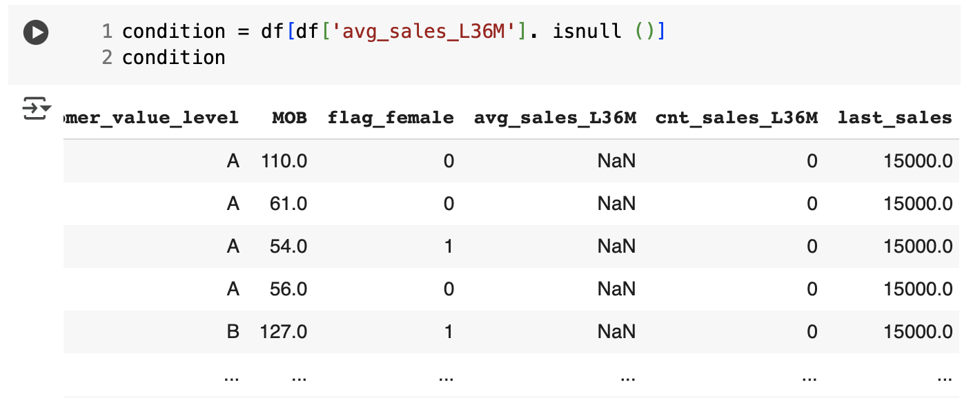
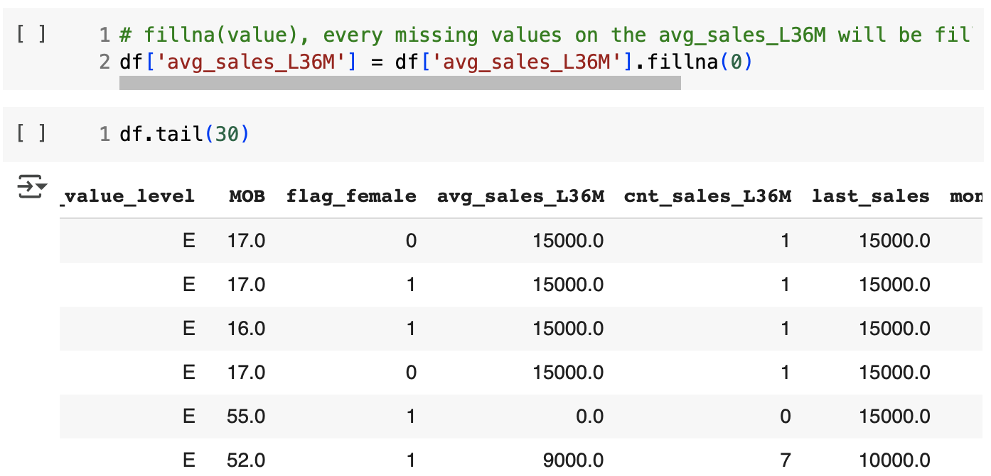
Data Cleaning (1/4)
1
Before
Handling Missing Values
when we check the data pattern, we find that where avg_sales_L36M = NaN always correspond to cnt_sales_L36M = 0 its means when a particular account hasn't made any purchases in the L36M (cnt_sales_L36M = 0) there is no average sales amount because they haven't spent any money with us (avg_sales_L36M =NaN), we suggest to fill the missing value in avg_sales_L36M = 0 to simplify future calculations.
1a
Code
After
condition = df[df['avg_sales_L36M']. isnull ()]
condition
# fillna(value), every missing values on the avg_sales_L36M will be fill with 0 as we suggest before
df['avg_sales_L36M'] = df['avg_sales_L36M'].fillna(0)
1b
Output
We have filled the values in the avg_sales_L36M column where it was NaN (Not a Number) with the value 0.
More results on Google Colab Notebook

Slide 15
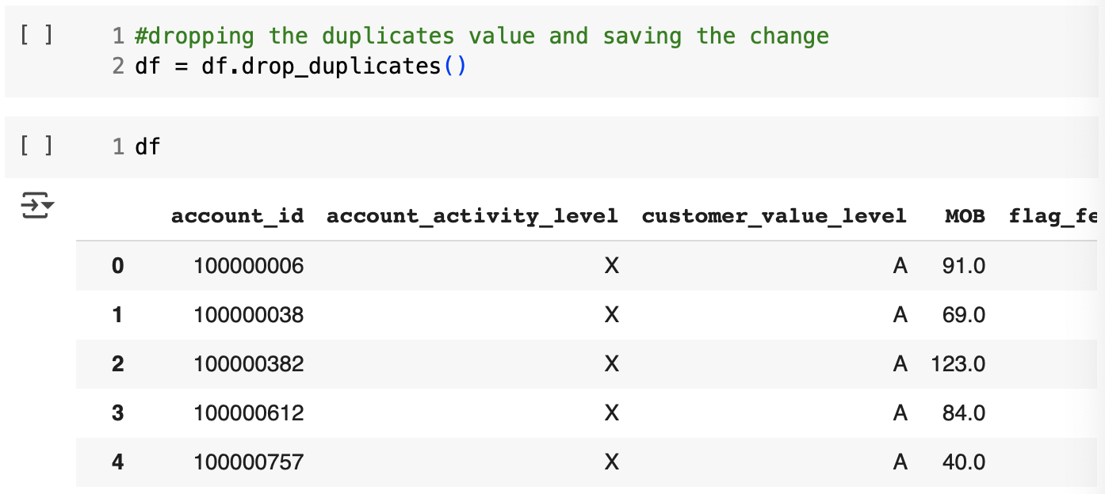
Data Cleaning (2/4)
1
Before
Dropping the Duplicates Values
We identified 144 rows with identical values across all columns. When we used the account_id column as the parameter for identifying unique values, we found the same number of duplicate rows. Since the data dictionary specifies that the account_id column should contain unique values, we will remove the duplicates to ensure uniqueness.
1a
Code
After
#dropping the duplicates value and saving the change
df = df.drop_duplicates()
1b
Output
After removing 72 duplicate rows, the total number of rows decreased from 12,559 to 12,487.
More results on Google Colab Notebook

Slide 16
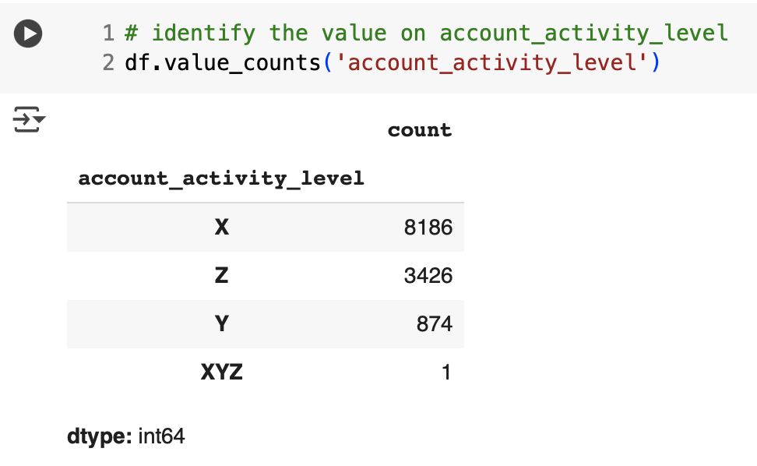
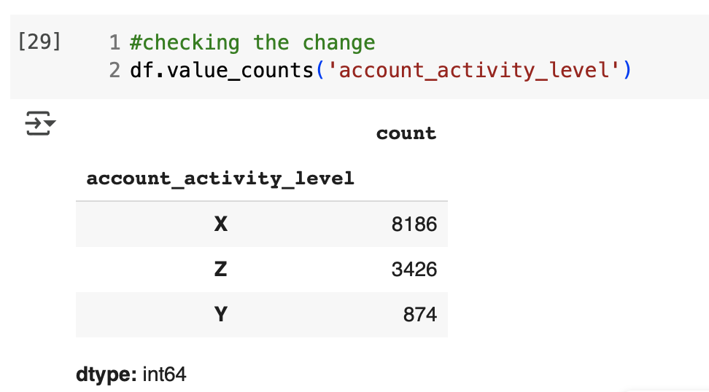
Data Cleaning (3/4)
1
Before
Removing Typo and Anomaly Values - 1
During data exploration, we found two potential anomalies:
account_activity_level = XYZ
customer_value_level = F
These values appear in only one row each and do not exhibit any trend, leading us to consider them as anomalies that should be removed.
1a
Code
# identify the value on account_activity_level
df.value_counts('account_activity_level')
#excluding XYZ value on account_activity_level and save the change
condition = ~(df['account_activity_level'] == 'XYZ')
df = df[condition]
df
#checking the change
df.value_counts('account_activity_level')
After
1b
Output
After excluding 1 row containing the value 'XYZ' in the 'account_activity_level' column, our row count changed from 12487 to 12486.
More results on Google Colab Notebook

Slide 17
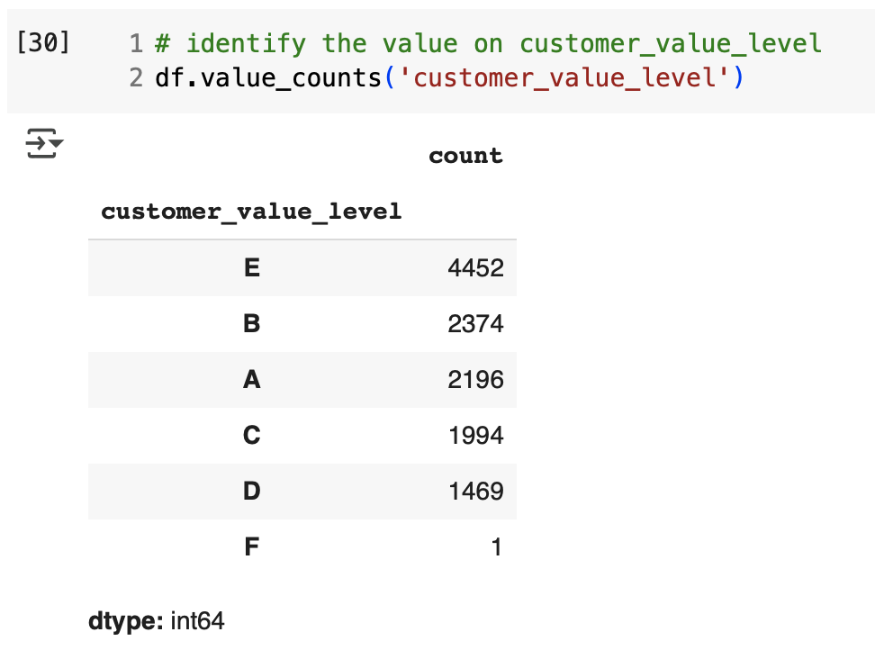
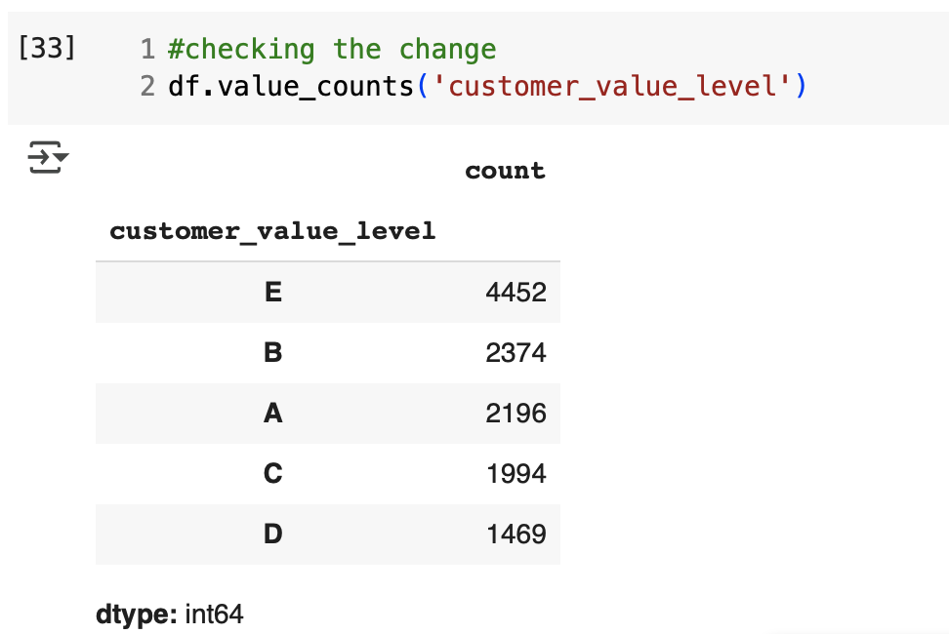
Data Cleaning (3/4)
1
Before
Removing Typo and Anomaly Values - 2
During data exploration, we found two potential anomalies:
account_activity_level = XYZ
customer_value_level = F
These values appear in only one row each and do not exhibit any trend, leading us to consider them as anomalies that should be removed.
1a
Code
# identify the value on customer_value_level
df.value_counts('customer_value_level')
#excluding F value on customer_value_level and save the change
condition = ~(df['customer_value_level'] == 'F')
df = df[condition]
df
#checking the change
df.value_counts('customer_value_level')
After
1b
Output
After excluding 1 row containing the value 'F' in the 'customer_value_level' column, our row count changed from 12486 to 12485.
More results on Google Colab Notebook

Slide 18
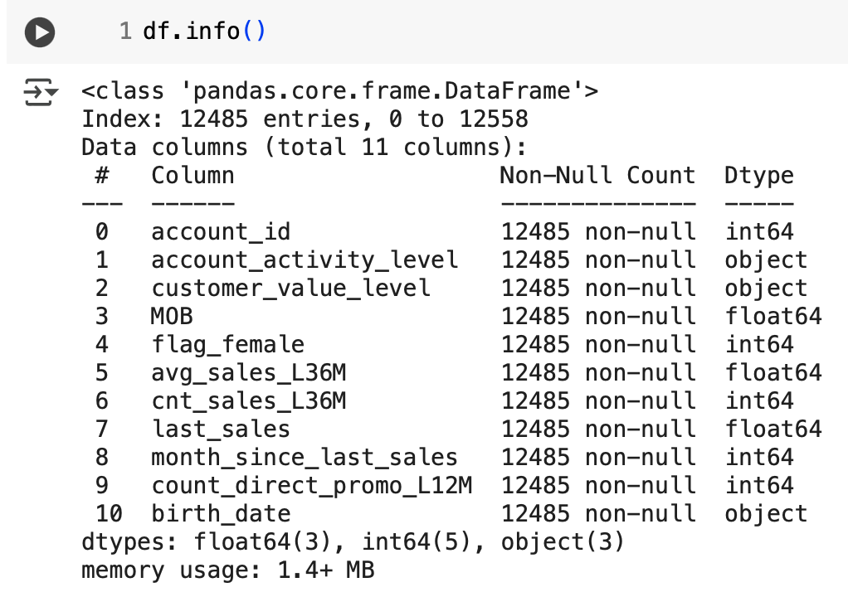
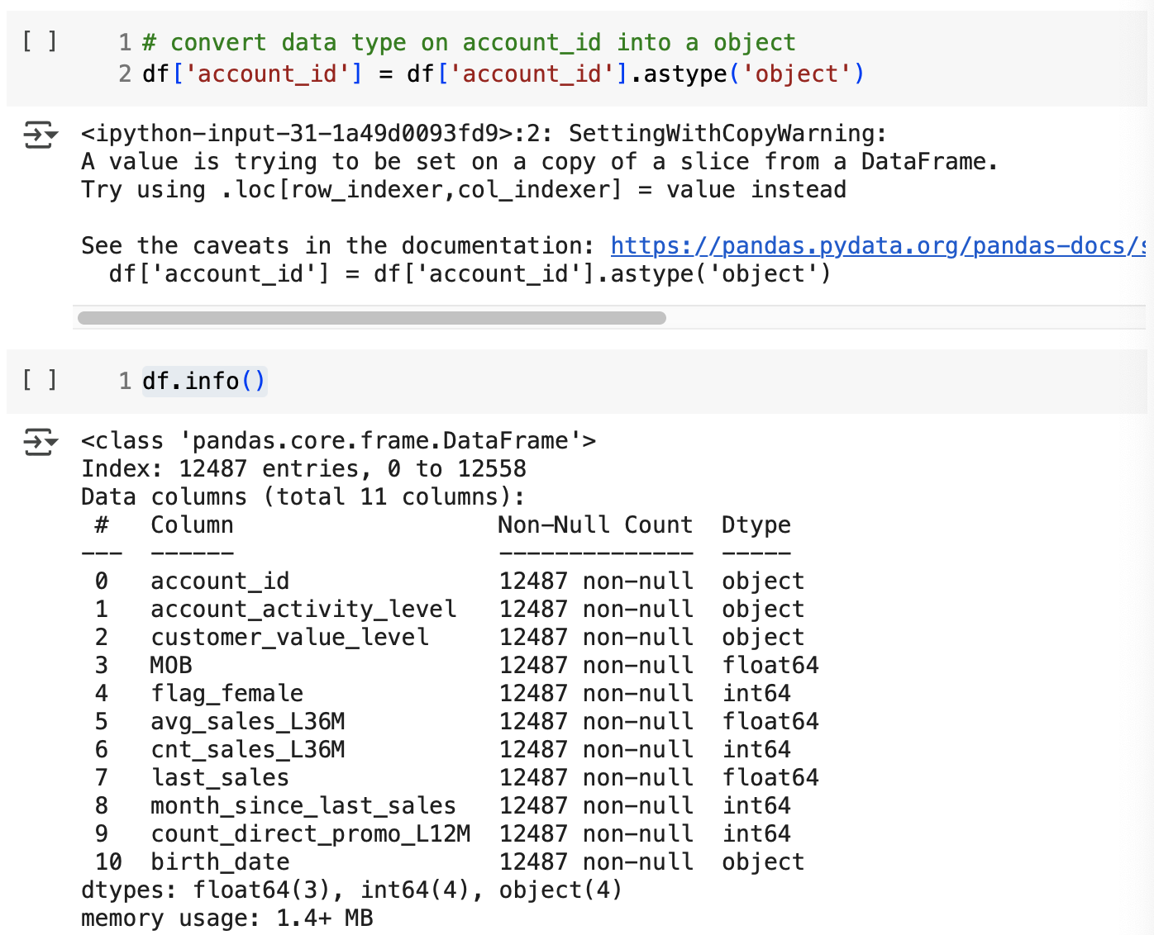
Data Cleaning (4/4)
Before
1
Changing the Data Type - 1
After handling missing values, removing duplicates and excluding typos, it was observed that certain columns had incorrect data types. These columns and the required corrections are as follows:
account_id: int-> object
MOB: float -> int
birth_date: object -> datetime
1a
Code
After
# convert data type on account_id into a object
df['account_id'] = df['account_id'].astype('object')
df.info()
1b
Output
The account_id column has been changed from an integer data type to an object data type.
More results on Google Colab Notebook

Slide 19
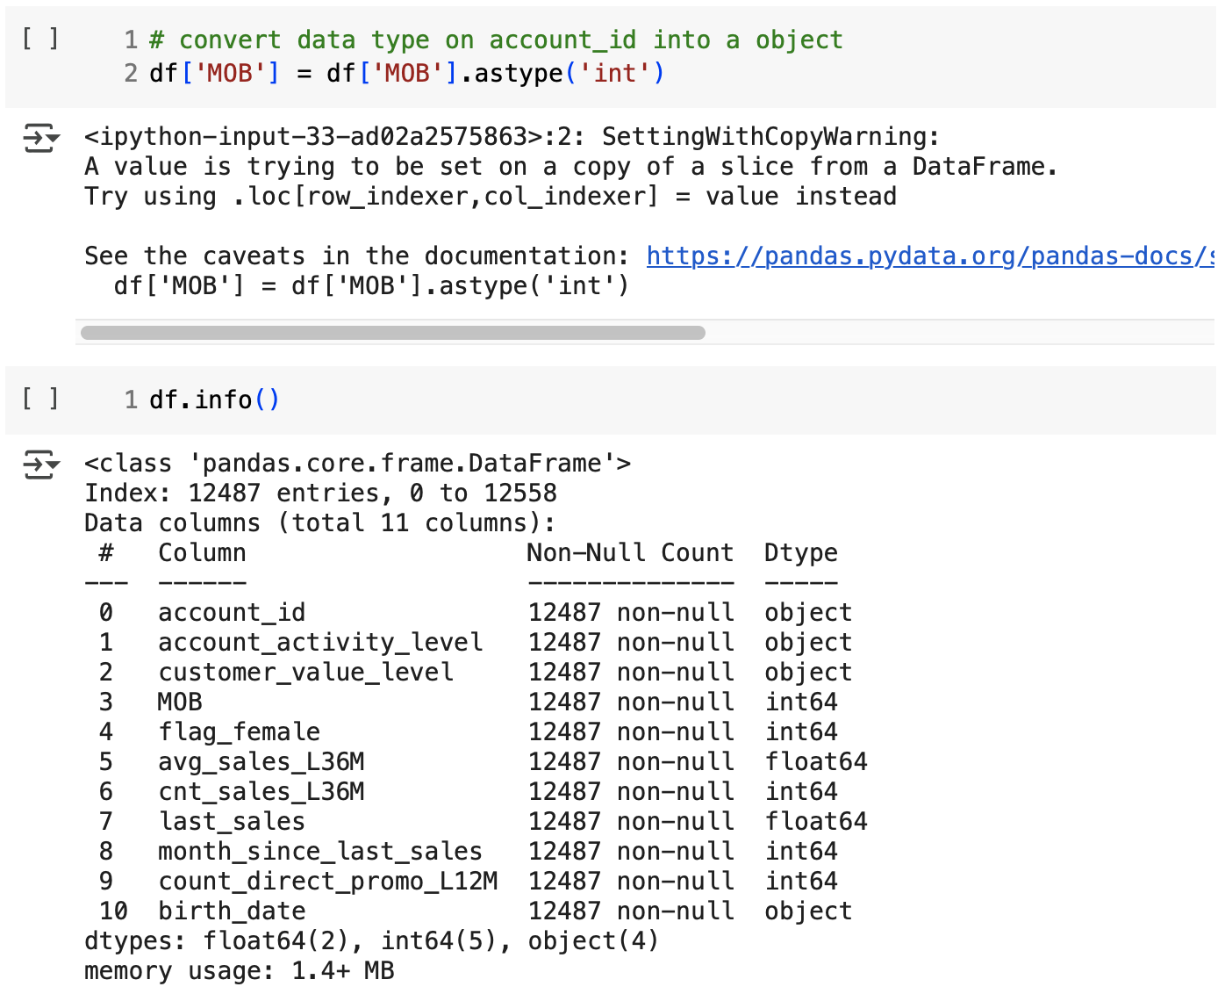
Data Cleaning (4/4)
Before
1
Changing the Data Type - 2
After handling missing values, removing duplicates and excluding typos, it was observed that certain columns had incorrect data types. These columns and the required corrections are as follows:
account_id: int-> object
MOB: float -> int
birth_date: object -> datetime
1a
Code
After
# convert data type on account_id into a object
df['MOB'] = df['MOB'].astype('int')
df.info()
1b
Output
The MOB column has been changed from a float data type to an integer data type.
More results on Google Colab Notebook

Slide 20
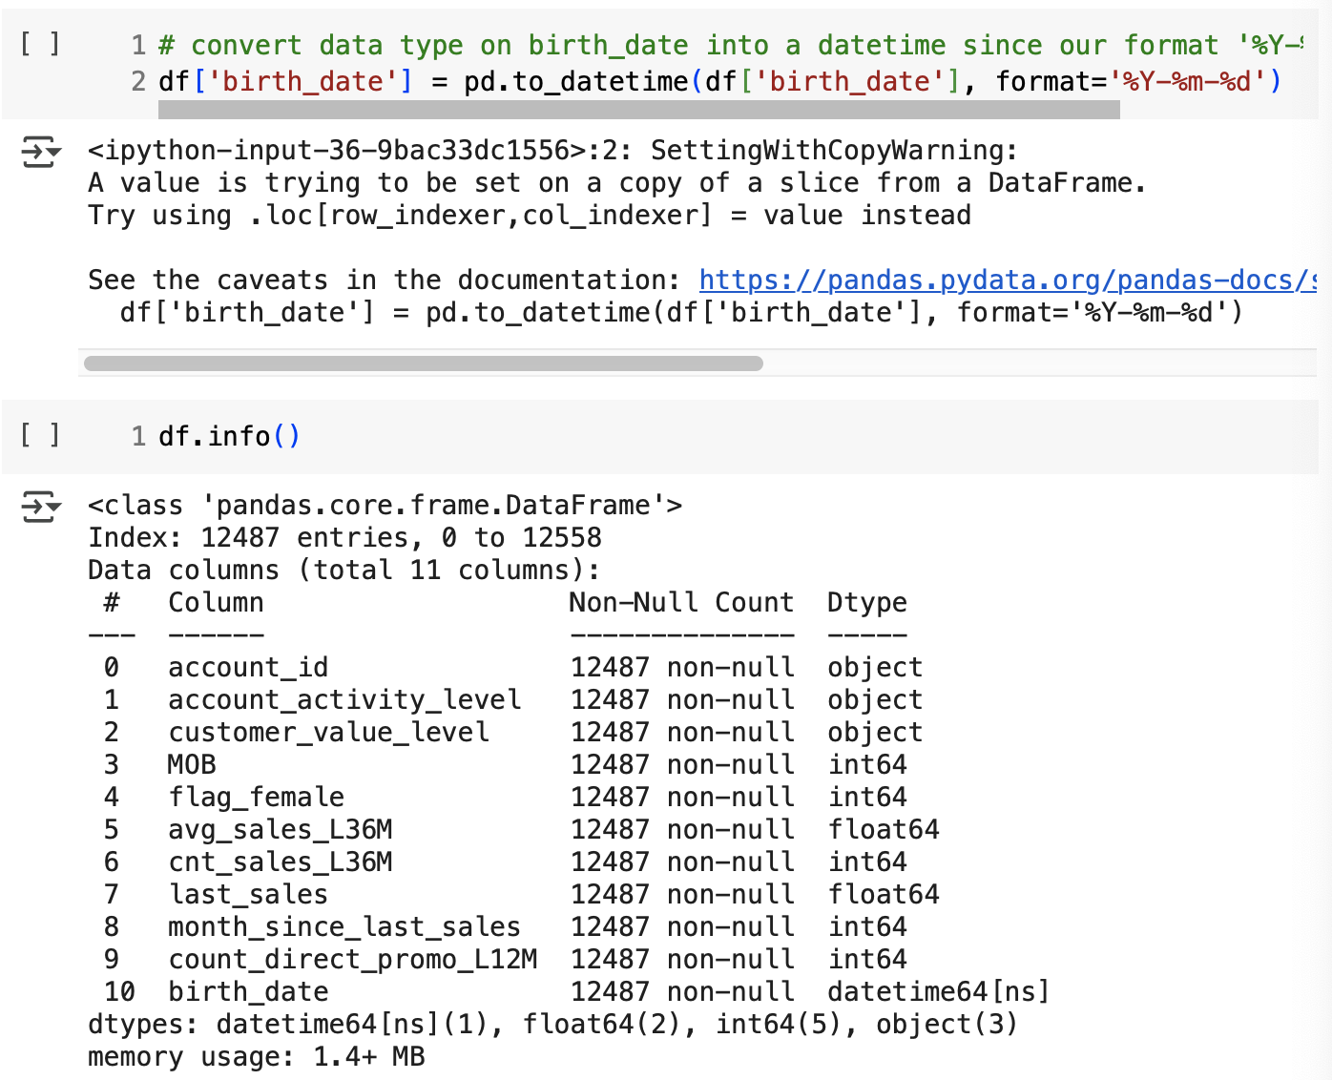
Data Cleaning (4/4)
Before
1
Changing the Data Type - 3
After handling missing values, removing duplicates and excluding typos, it was observed that certain columns had incorrect data types. These columns and the required corrections are as follows:
account_id: int-> object
MOB: float -> int
birth_date: object -> datetime
1a
Code
After
# convert data type on birth_date into a datetime since our format '%Y-%m-%d'
df['birth_date'] = pd.to_datetime(df['birth_date'], format='%Y-%m-%d')
df.info()
1b
Output
The birth_date column has been changed from a object data type to a datetime data type.
More results on Google Colab Notebook

Slide 21
Adding New Column

Slide 22
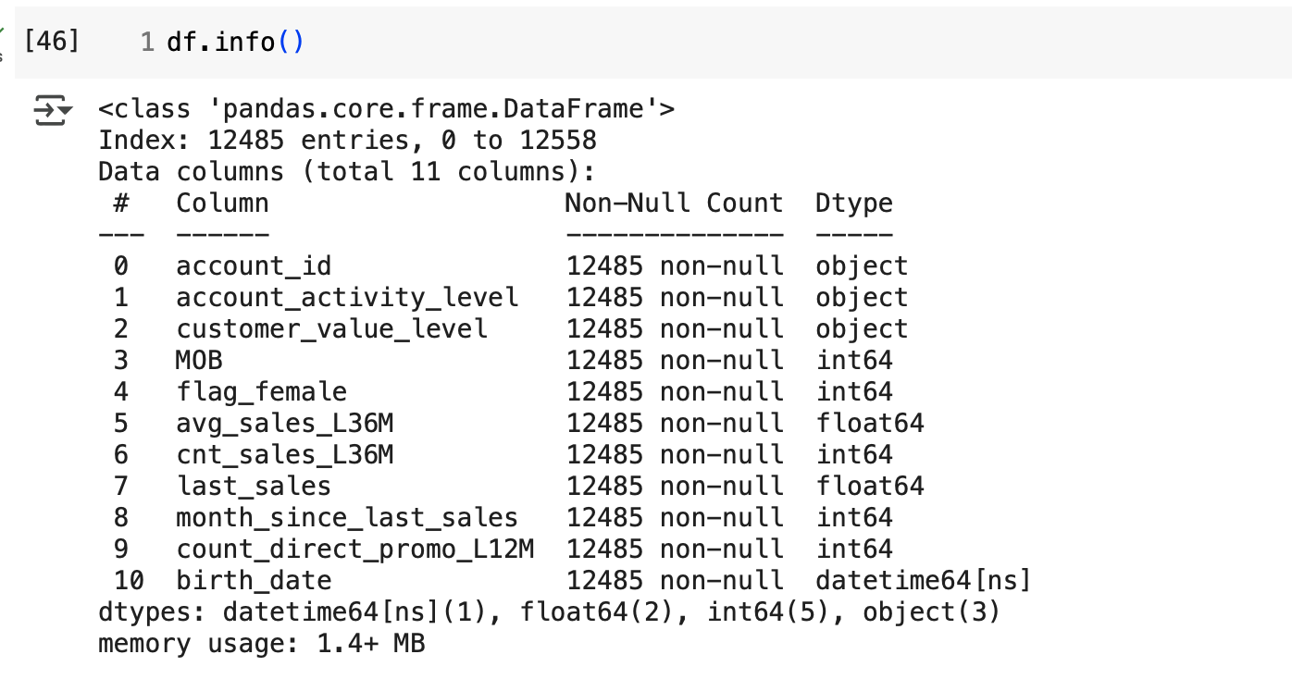
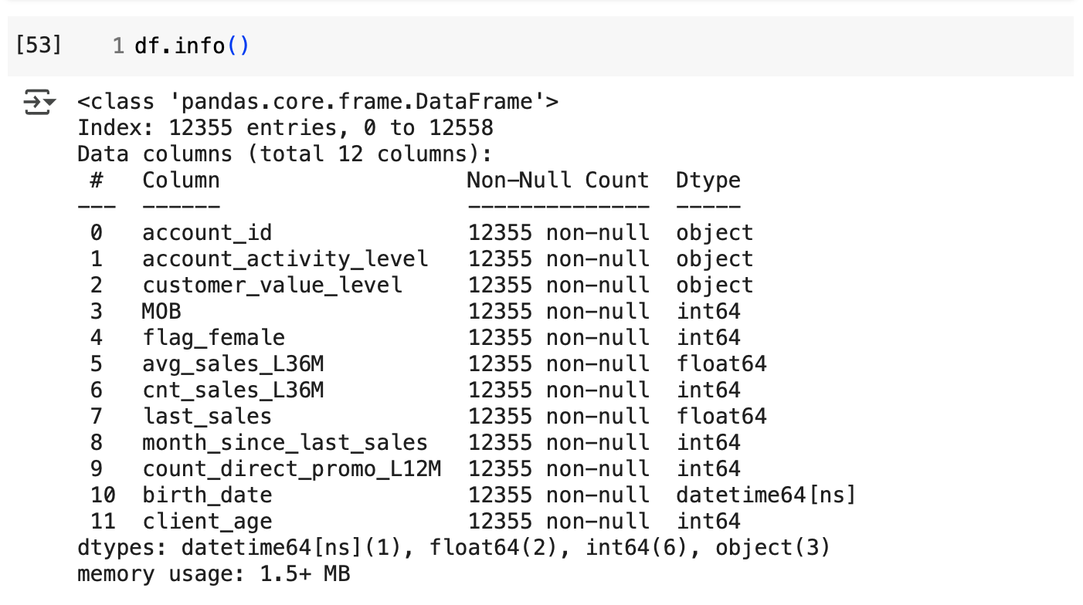
Adding Client’s Column
Before
1
Adding New Column and Filtering The Data Based on Certain Condition
Based on the client's birth date, calculate each client's age as of May 31, 2023. For this analysis, remove any client with age less than 21.
1a
Code
# Import the datetime object from the datetime module
from datetime import datetime
# Define cutoff_date
cutoff_date = datetime(year=2023, month=5, day=31)
# Since age is in year, we floor divide by "Y", so // np.timedelta64(1,'Y')
df['client_age'] = round((cutoff_date - df['birth_date']).dt.days // 365)
df
#removing any client with age less than 21 using condition function
condition = df['client_age'] >= 21
df = df[condition]
df
After
1b
Output
The client_age column has been added and a filter has been applied to clients under 21 years old, resulting in 130 rows being removed. The data has been reduced from 12485 rows to 12355 rows.
More results on Google Colab Notebook

Slide 23
Summary

Slide 24
Summary
Step | Before Cleaning | After Cleaning | Why This Step is Needed?
Initial Check | Data wasn’t reviewed yet | Looked at the data to check for issues | Helps understand the data before making any changes.
Fixing Missing Values | avg_sales_L36M had missing values (NaN) | Replaced NaN values with 0 | Since cnt_sales_L36M was 0 when avg_sales_L36M was missing, it indicates no purchases in the last 36 months. Replacing NaN with 0 ensures numerical consistency and future calculations.
Removing Duplicates | Found 144 duplicate rows (72 pairs) | Removed 72 duplicate rows | Keeps only unique records, avoids counting the same customer twice.
Fixing Incorrect Categories | account_activity_level had an extra category (XYZ), which appeared once | Removed the 1 record with XYZ category | Since XYZ only appeared in one row and showed no clear pattern, it was assumed to be an outlier and removed.
 | customer_value_level had an extra category (F), which appeared once | Removed the 1 record with F category | Since F only appeared in one row and showed no clear pattern, it was assumed to be an outlier and removed.
Fixing Data Types | account_id was a number (int) | Changed account_id to text (str) | account_id is a unique identifier, not a numerical value for calculations. Changing it to text prevents unintended mathematical operations.
 | MOB was a decimal (float) | Changed MOB to whole number (int) | MOB shows months, so it should be a whole number.
 | birth_date was text (object) | Changed birth_date to date format (datetime) | birth_date contains date of birth, so converting it to datetime format makes it easier for time-based analysis, such as calculating age etc.
Adding Age Column | No age column in the dataset | Added age column based on birth_date (cut off May 31, 2023) | Age helps in customer segmentation and analysis.
More results on Google Colab Notebook

Slide 25
Descriptive Statistics

Slide 26
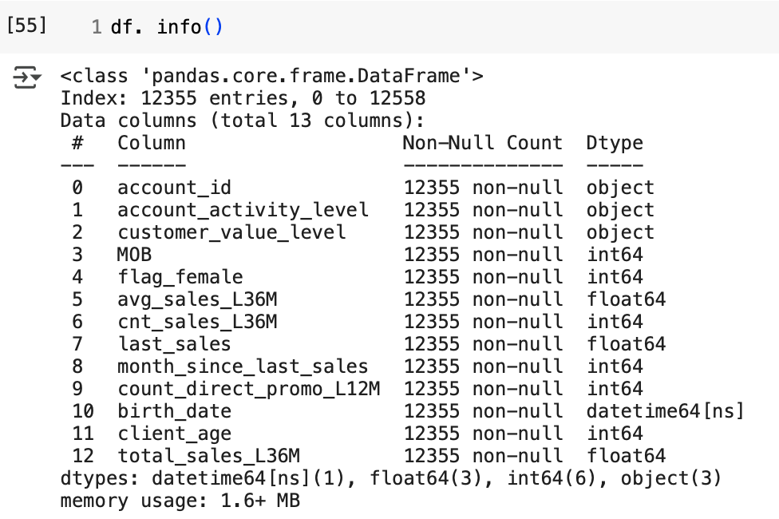
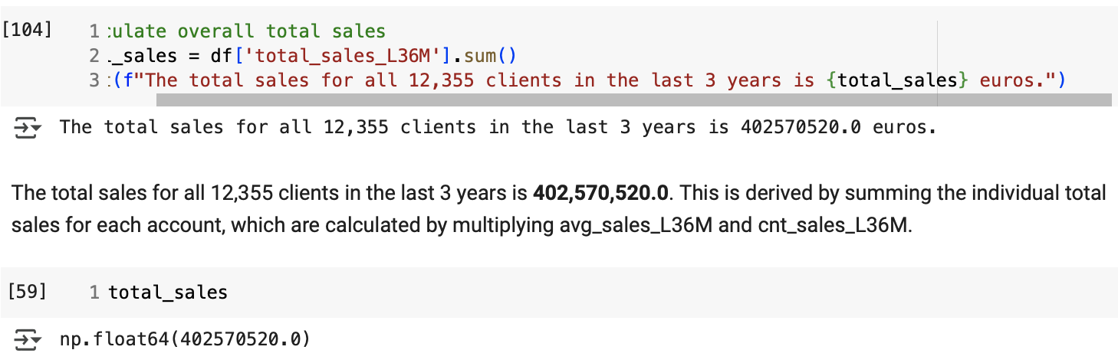
Total Sales in The Last 3 Years
1
Calculate the total sales in the last 3 years
Following data cleaning, we initiate exploratory analysis by Calculate total sales for each account by multiplying average sales and sales count in the past 3 years. Then, sum all total sales using .sum ())
1a
Code
# Step 1: calculate total sales = avg_sales_L36M * cnt_sales_l36M
df['total_sales_L36M'] = (df['avg_sales_L36M'] * df['cnt_sales_L36M']
df. info()
df.head()
#calculate overall total sales
total_sales = df['total_sales_L36M'].sum()
print(f"The total sales for all 12,355 clients in the last 3 years is {total_sales} euros.")
1b
Insight
The total sales for all 12,355 clients in the last 3 years is 402,570,520.0 euros. This is derived by summing the individual total sales for each account, which are calculated by multiplying avg_sales_L36M and cnt_sales_L36M.
More results on Google Colab Notebook

Slide 27
Number of Clients with No Sales in the Past 36 Months
1
Identify the number of clients with no sales in the past 36 months
We will calculate the percentage of clients with no sales transactions in the past 36 months and visualize it using a pie chart.
1a
Code
# Step 1 : assign the column into a variable
ts=df['total_sales_L36M']
# Step 2 : creating category from total_sales_L36M use loc to filter clients with total sales = 0
# Diving into 2 category and inpute as sales_status_L36M column
df.loc[(ts == 0), 'sales_status_L36M'] ='Inactive' #total sales = 0
df.loc[(ts > 0), 'sales_status_L36M'] = 'Active' #total sales > 0
# Step 3a : using info to calculate numbers of inactive clients
df[df['sales_status_L36M'] == 'Inactive'].info()
# Step 3b : alternative 2 using .value_counts to calculate number of sales_status_L36M on each category
sales_status_L36M = df['sales_status_L36M'].value_counts().reset_index(name= 'number_of_users')
sales_status_L36M
# Step 4 : calculate number of sales_status_L36M on each category using percentage
sales_status_L36M_percentage = df['sales_status_L36M'].value_counts(normalize=True).reset_index(name= 'number_of_users')
sales_status_L36M_percentage
# Step 5: Create pie chart
plt.subplots(figsize=(6,6))
plt.pie(sales_status_L36M['number_of_users'], #value to be plotted
labels= sales_status_L36M['sales_status_L36M'], #labelin
autopct='%.2f%%' #for annotate (show) percentage (rounded up tp 2 ) in each pie category
); #tanda ";" di akhir function untuk show plot
# Adding legend
plt.legend()
# Adding title
plt.suptitle('Distribution of Sales Status in the Last 36 Months', fontweight='bold', fontsize=14)
plt.title('Percentage of Clients in Each Sales Status', fontsize=12)
plt.show()
More results on Google Colab Notebook

Slide 28
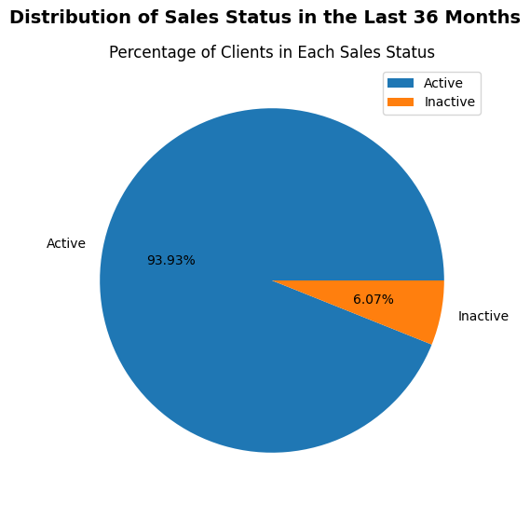
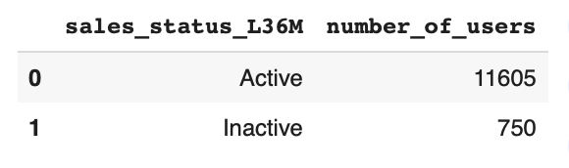
Number of Clients with No Sales in the Past 36 Months
93.93% (11,605 clients) are active, having made purchases in the last 36 months.
Only 6.07% (750 clients) are inactive — no purchases in the same period.
Active clients outnumber inactive ones 15 to 1, signaling strong retention.
The fact that the active client group is significantly larger than the inactive client group suggests that RevoBank has a relatively high client retention rate. This is a positive indicator for the bank's overall performance.
We can prioritize strategies by strengthen engagement of active clients via personalized offers & loyalty programs and re-engage inactive clients with targeted win-back campaigns and incentive-based outreach.
More results on Google Colab Notebook

Slide 29
Does Level X Reflect True Activity?
1
Validating Account Activity Levels
To prove that account activity level "X" is the most active, we analyze the median and average transaction counts over the past three years for each level. We present this analysis visually using a bar chart, enabling clear comparisons.
1a
Code
# Step 1: Group by account activity level and calculate median and average transaction counts over the past three years for each level
activity_level_summary = df.groupby(['account_activity_level']).agg({
'month_since_last_sales': 'median',
'cnt_sales_L36M': 'mean'
}).rename(columns={
'month_since_last_sales': 'median_month_since_last_sales',
'cnt_sales_L36M': 'avg_cnt_sales_L36M'
})
activity_level_summary
# Step 2: create bar chart median
# Set chart size
plt.subplots(figsize=(10,6))
# Access the index instead of column for 'account_activity_level'
value = plt.bar(activity_level_summary.index, activity_level_summary['median_month_since_last_sales'])
# Adding x-label and y-label
plt.xlabel('Account Activity Level', fontsize=10)
plt.ylabel('Median of Month Since Last Sales', fontsize=10)
# Adding title
plt.title('Median of Month Since Last Sales per Account Activity Level', fontweight='bold', fontsize=14)
# Adding label. Padding = 2, artinya memberi jarak dari angka ke bar-nya plt.bar_label(value, padding=2, fontsize=11);
# Step 3: round avg_cnt_sales_L36M
activity_level_summary['avg_cnt_sales_L36M'] = activity_level_summary['avg_cnt_sales_L36M'].round(0)
activity_level_summary
# Step 4: create bar chart for average
# Set chart size
plt.subplots(figsize=(10,6))
# Access the index instead of column for 'account_activity_level'
value = plt.bar(activity_level_summary.index, activity_level_summary['avg_cnt_sales_L36M'])
# Adding x-label and y-label
plt.xlabel('Account Activity Level')
plt.ylabel('Average number of transactions in the Last 36 Months')
# Adding title
plt.title('Average number of transactions in the Last 36 Months per Account Activity Level', fontweight='bold', fontsize=14)
# Adding label. Padding = 2, artinya memberi jarak dari angka ke bar-nya. Makin besar angkanya, makin jauh posisi angka dr bar
plt.bar_label(value, padding=2, fontsize=11);
More results on Google Colab Notebook

Slide 30
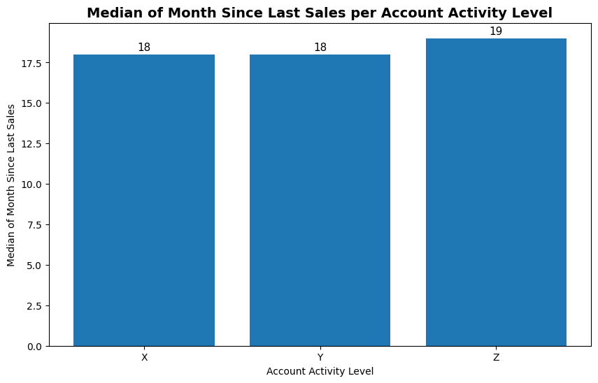
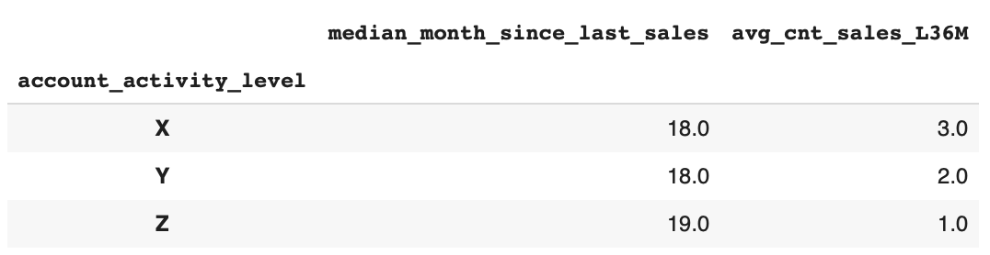
Does Level X Reflect True Activity?
The median months since last purchase across all activity groups—X (18), Y (18), and Z (19)—are nearly identical, indicating that at least 50% of accounts in each group haven’t made a purchase in over 1.5 years
Despite Group X being labeled as the "most active", its recency of purchase is not significantly better than Groups Y or Z. The difference in median values is minimal, suggesting similar levels of inactivity across all groups.
The current account activity labeling system may not reflect actual engagement. RevoBank should consider redefining activity tiers using data-driven behavioral metrics (e.g., purchase recency and frequency) to enable more accurate targeting and personalized engagement strategies.
More results on Google Colab Notebook

Slide 31
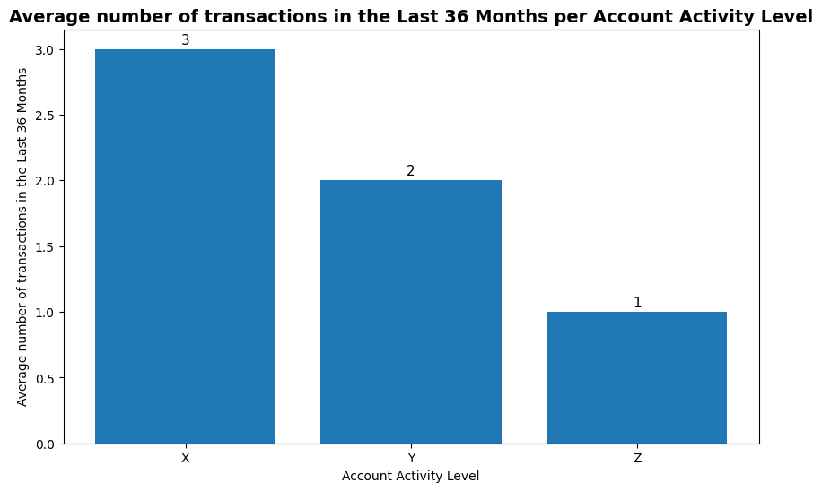
Does Level X Reflect True Activity?
On average, clients in Level X made 3 transactions in the last 36 months, compared to 2 transactions for Level Y and only 1 transaction for Level Z, indicating a clear decreasing trend in transaction frequency across the levels.
Although the median recency of transactions is similar across all account levels (around 18–19 months), Level X shows a noticeably higher average transaction count over the past 36 months, indicating more frequent engagement. However, evaluating the accuracy of activity level classifications shouldn’t rely solely on central tendency metrics like median or mean. To ensure more robust segmentation, additional behavioral indicators—such as value per transaction—should be considered.
We should reassess the account activity classification using more than just averages or medians to better capture client behavior and ensure the segments reflect true engagement.
More results on Google Colab Notebook

Slide 32
Is Male More Profitable Than Female?
1
Analyzing profit based on Gender
To assess whether male clients are more profitable than female clients, we first calculated individual client profit by applying a 2.4% profit margin to each client’s total sales. We then grouped the data by gender and used aggregate statistics—including mean, median, and distribution—to compare profitability across segments. Finally, we visualized the results using boxplots to better understand the spread, central tendency, and presence of outliers in each group.
1a
Code
# Step 3: create boxplot
# Set chart size
plt.figure(figsize=(10, 6))
# Create boxplot using seaborns
sns.boxplot(x='flag_female', y='profit', data=df)
# Adding title
plt.title('Profit by Gender',fontweight='bold', fontsize=14)
# Adding label
plt.ylabel('Profit per Client (€)')
plt.show()
# Step 1 : Calculate profit
df['profit']=df['total_sales_L36M']* 0.024
# Step 2: Group by flag_female and aggregate using various statistics
profit_by_gender_2 = df.groupby(['flag_female']).agg({
'flag_female' : 'count',
'profit' : ['sum','mean', 'min', 'median', 'max']
}).reset_index()
profit_by_gender_2
More results on Google Colab Notebook

Slide 33
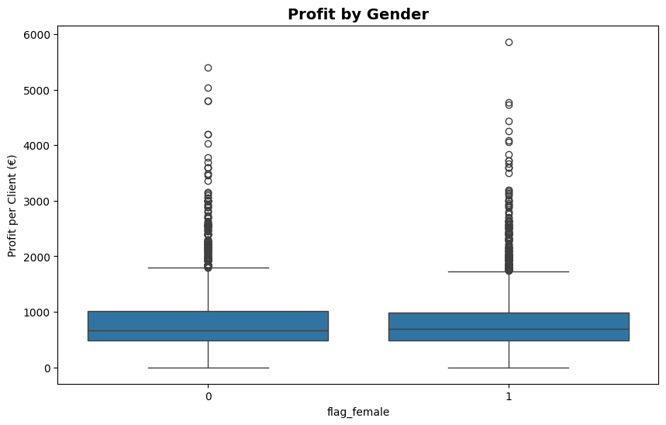
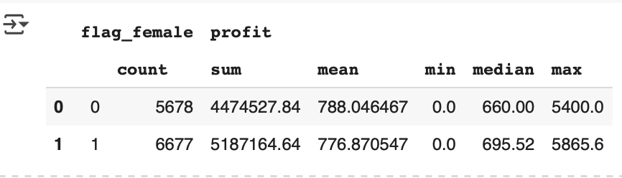
Is Male More Profitable Than Female?
Male clients show a higher average profit (788.05 euros) than females (776.87 euros), but the difference is small (11.18 euros). Female clients have a higher median profit (695.52 euros) compared to males (660.00 euros), indicating more consistent profitability among the majority of female clients.
Male’s higher average profit is influenced by a few high-value outliers, not consistent performance.
Despite lower average profit, female clients (5,187,164.64 euros) deliver higher total profit and more centralized profit distribution supported by higher median and tighter distribution in the box plot.
We should target high-performing male outliers for tailored upsell opportunities. while also leveraging the stable profit behavior of female clients for long-term strategic campaigns.
More results on Google Colab Notebook

Slide 34
Proportion of Total Sales Based on Generation
1
Proportion of Total Sales Based on Generation
We will perform binning on the birth date column to categorize clients into generational groups based on their year of birth. Then, we will calculate each generation's proportion of total sales and visualize the results using a bar chart.
1a
Code
# Step 1: Extract the year of birth
df['birth_year'] = df['birth_date'].dt.year
df.head()
df['birth_year'].describe()
# Step 2: Adding to column the categorize clients into generations: Boomer: 1946 - 1964, Gen-X = 1965 - 1980, Millennial = 1981 - 1996, Gen-Z = 1997 -2012
df['generation'] = pd. cut(
df['birth_year'], # kolom yang mau di-binning/dikelompokkan
[1946, 1964, 1980, 1996, 2012], # batas binning-nya
labels = ['Boomer', 'Gen-X', 'Millennial', 'Gen-Z'], # nama untuk setiap bin
include_lowest=True,
)
# Step 3: Group by generation and calculate number_of_clients, number_of_sales,avg_number_of_sales,total_sales,avg_sales
sales_by_generation = df.groupby('generation').agg(
number_of_clients =('account_id', 'nunique'),
number_of_sales = ('cnt_sales_L36M', 'sum'),
avg_number_of_sales=('cnt_sales_L36M', 'mean'),
total_sales=('total_sales_L36M', 'sum'),
avg_sales=('total_sales_L36M', 'mean'),
).reset_index()
sales_by_generation
# Step 4: Calculate sales proportion, adding on our sales_by_generation df
sales_by_generation['proportion_sales'] = sales_by_generation['total_sales'] / sales_by_generation['total_sales'].sum()
sales_by_generation
# Step 5: Create bar chart
# Ensure correct order
gen_order = ['Boomer', 'Gen-X', 'Millennial', 'Gen-Z']
sales_by_generation['generation'] = pd.Categorical(sales_by_generation['generation'], categories=gen_order, ordered=True)
# Set bar colors (highlight max)
colors = ['blue' if x == sales_by_generation['proportion_sales'].max() else 'lightblue' for x in sales_by_generation['proportion_sales']]
# Plot
plt.figure(figsize=(10, 6))
sns.barplot(data=sales_by_generation, x='generation', y='proportion_sales', palette=colors)
# Add % labels
for i, val in enumerate(sales_by_generation['proportion_sales']):
plt.text(i, val + 0.01, f'{val*100:.2f}%', ha='center', fontsize=10)
plt.title('Proportion of Total Sales by Generation (Past 3 Years)', fontsize=14, fontweight='bold')
plt.ylabel('Proportion of Sales')
plt.xlabel('Generation')
plt.gca().yaxis.set_major_formatter(plt.matplotlib.ticker.PercentFormatter(1.0))
plt.tight_layout()
plt.show()
More results on Google Colab Notebook

Slide 35
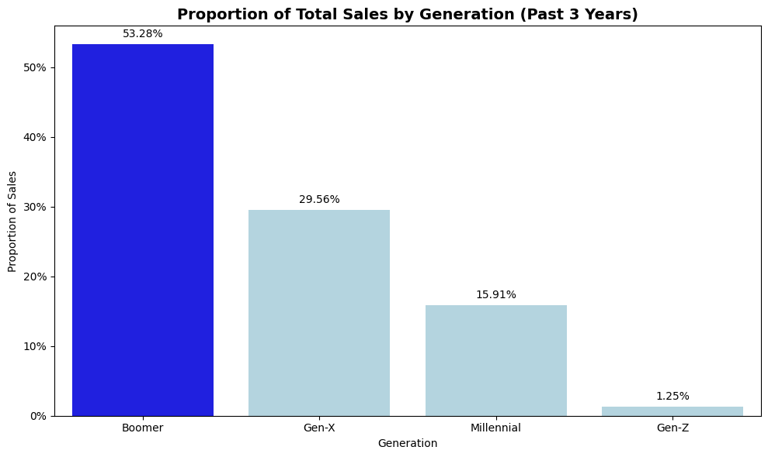
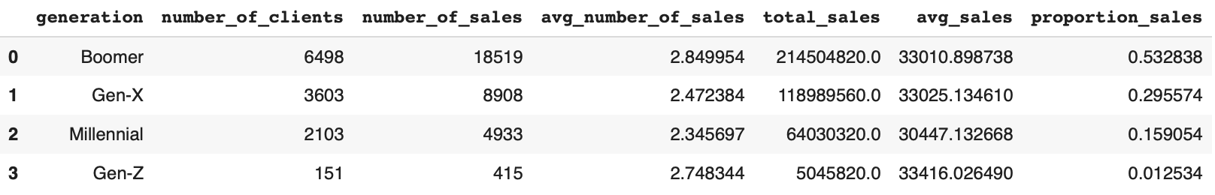
Proportion of Total Sales Based on Generation
Sales contribution trends downward across generations, from Boomers to Gen-Z.
Boomers and Gen-X drive over 80% of total sales, with large client bases and high average sales—key revenue contributors.
Gen-Z contributes just 1.25%, but has the highest average sales per client (33,416 euros), likely due to outliers—indicating future potential.
RevoBank should implement loyalty programs or exclusive offers for Boomers and Gen-X to retain their engagement and revenue, analyze Gen-Z high-spender profiles to The bank should also identify niche markets and tailor premium offerings to capture future high-value clients and Millennial engagement should be boosted through relevant, value-driven campaigns that align with their current behavior and preferences.
More results on Google Colab Notebook

Slide 36
Is There a Relationship Between Promotion and Sales?
1
Relationship Analysis between Increasing The Number of email and SMS Messages and improved total sales performance
We will filter data where month_since_last_sales <=11 to include customers with purchases within the promotional period. After that we will bin count_direct_promo_L12M into four categories: low, moderate, high, and saturated, to reduce data variation and group the data by these promotion categories and calculate the total sales for each, last, we will visualize the relationship between promotion intensity and total sales using a line chart.
1a
Code
# Step 1: Filter customers who made a purchase in the last 12 months, so their last purchase happened within the last 12 months
df_active = df[df['month_since_last_sales'] <= 12]
df_active
# Step 2b: Binning 'count_direct_promo_L12M'
# Define min and max
min_promo = df_active['count_direct_promo_L12M'].min()
max_promo = df_active['count_direct_promo_L12M'].max()
# Binning 'count_direct_promo_L12M'
# with the category: low =2-5, moderate= 6-9, high= 10-13, saturated = >=14
df_active ['active_promotion_group'] = pd.cut(
df_active['count_direct_promo_L12M'], # kolom yang mau di-binning/dikelompokkan
[min_promo,5,9,13, max_promo], # batas binning-nya
include_lowest=True,
labels = ['low', 'moderate', 'high', 'saturated'] #generate labels
)
# Rename labels menjadi rename('active_promotion_group')= ['low (2-5)', 'moderate (6-9)', 'high (10-13)', 'saturated (>14)']
df_active['active_promotion_group'] = df_active['active_promotion_group'].cat.rename_categories({'low': 'low (2-5)', 'moderate': 'moderate (6-9)', 'high': 'high (10-13)', 'saturated': 'saturated (>14)'})
# Step 3b : group by based on active_promotion_group and aggregate using sum on total_sales_L36M
sales_by_promo_L12M_2 = df_active.groupby('active_promotion_group')['total_sales_L36M'].sum().reset_index()
sales_by_promo_L12M_2
# Step 4b: create line chart
# Set chart size
plt.figure(figsize=(10, 6))
# Create line chart
sns.lineplot(data=sales_by_promo_L12M_2, x='active_promotion_group', y='total_sales_L36M')
# Adding title
plt.title('Total Sales vs. Number of Direct Promotions (on Active Client <=11 Months)', fontsize=14, fontweight='bold')
# Adding label
plt.xlabel('Number of Direct Promotions')
plt.ylabel('Total Sales')
plt.show()
More results on Google Colab Notebook

Slide 37
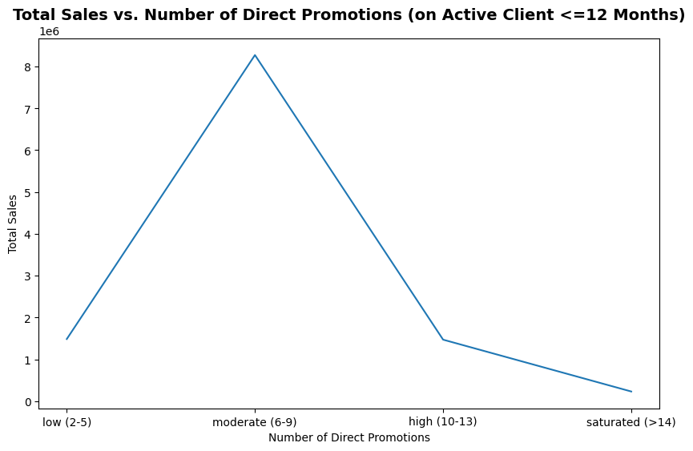
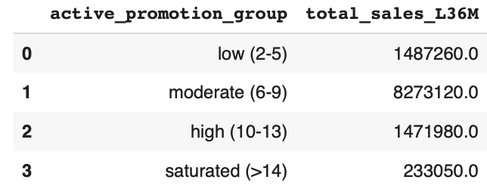
Is There a Relationship Between Promotion and Sales?
Total Sales vs. Number of Direct Promotions (on Active Client ≤12 Months) indicates a clear non-linear trend in sales performance relative to promotional frequency.
Clients who received 6–9 promotions per year generated the highest total sales at 8,273,120 euros, making this the most effective frequency for driving purchases.
As the number of promotions exceeds 9, sales drop sharply—down to 1,378,980 euros in the high group (10–13 promotions) and further down to 233,050 euros for those receiving more than 14. This trend indicates a risk of promotion fatigue, where too much communication may lead to disengagement or annoyance, thereby reducing sales effectiveness.
To optimize performance, the bank should focus its promotional strategy within this effective range, while also monitoring customer response patterns and personalizing communication based on engagement behavior. Balancing frequency with message relevance will help maintain customer interest and drive sustained sales
More results on Google Colab Notebook

Slide 38
Findings and Recommendations

Slide 39


Findings and Recommendations
Top 3 Key Findings
Boomers and Gen-X are the primary revenue drivers, contributing a combined 82.84% of total sales, with both showing high average sales per client. Gen-Z shows the highest average sales per client (33,416 euros), though likely skewed by a few high-value outliers — signaling early potential for future high-value growth.
Promotional effectiveness peaks at 6–9 messages/year, generating the highest total sales (8M euros), while exceeding 9 promotions leads to a sharp sales decline, indicating promotion fatigue.
Female clients demonstrate more consistent profitability than males, with higher median profit and tighter distribution—indicating stronger long-term value potential.
Top 3 Recommended Actions
Focus on retaining Boomers and Gen-X by offering personalized loyalty programs and age-friendly services, such as priority assistance, simplified processes, or exclusive financial benefits. These tailored conveniences can strengthen emotional connection, reinforce loyalty, and sustain revenue from these high-value segments.
Design 6–9 messages/year promotional campaigns tailored to individual client behavior, launching each campaign during their personal peak engagement periods. Use transaction history, channel preference, and responsiveness patterns to optimize content, delivery timing, and frequency—ensuring relevance while avoiding communication fatigue.
Launch targeted campaigns for female clients, such as a "RevoLadies Club" or "Women & Wealth" program, which offer personalized financial perks, community-based benefits, and lifestyle-aligned services—leveraging their consistent profitability for long-term value.
More results on Google Colab Notebook

Slide 40
Customer Segmentation Using RFM

Slide 41
Why Using RFM Analysis for RevoBank’s User Segmentation?
Best for Behavior-based segmentation based on customer transactions.
Easy to Interpret
Can directly inform marketing strategy (e.g. who to win back, who to upsell)
Requires minimal preprocessing
More results on Google Colab Notebook

Slide 42
Defining RFM Analysis Features
Recency
month_since_last_sales — represents the number of months since the client's last sales activity (lower values indicate more recent activity)
Frequency
cnt_sales_L36M — represents how many sales transactions the client made in the last 36 months
Monetary
total_sales_L36M — represents the total value of sales over the last 36 months, indicating the client's purchasing power
More results on Google Colab Notebook

Slide 43
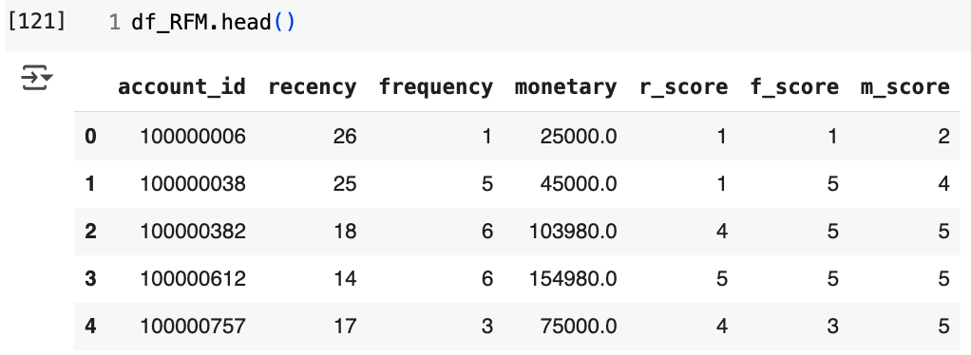
Create RFM Segmentation
After we determine the features that represent RFM, we begin segmentation using pd.qcut, where q = 5, which results in scores as follows:
Code
Outout
# Step 1: define RFM Variable
# Create recency variable
df.loc[:, 'recency'] = df['month_since_last_sales']
# Create frequency variable
df.loc[:, 'frequency'] = df['cnt_sales_L36M']
# Create monetary variable
df.loc[:, 'monetary'] = df['total_sales_L36M']
# Select RFM columns only
df_RFM = df[['account_id','recency', 'frequency', 'monetary']]
# Step 2 : checking RFM Segments
# For example, let's have a look on recency
pd.qcut(df_RFM['recency'], q=5).value_counts()
# monetary binning
pd.qcut(df_RFM['monetary'], q=5).value_counts()
# Now, let's try to bin frequency
pd.qcut(df_RFM['frequency'], q=5, duplicates = 'drop').value_counts()
# Step 3 : Create RFM Score
df_RFM.loc[:, 'r_score'] = pd.qcut(df_RFM['recency'], q=5, duplicates='drop', labels=pd.Categorical([5, 4, 3, 2, 1]))
df_RFM.loc[:, 'f_score'] = pd.qcut(df_RFM['frequency'], q=5, duplicates='drop', labels=[1, 2, 3, 4, 5])
df_RFM.loc[:, 'm_score'] = pd.qcut(df_RFM['monetary'], q=5, duplicates='drop', labels=pd.Categorical([1,2,3,4,5]))
RFM Segmentation Rules
Recency (Lower is better, scored 5-1)
(2.999, 16.0]: 5 (the best) - Customers who purchased most recently
(16.0, 18.0]: 4
(18.0, 19.0]: 3
(19.0, 23.0]: 2
(23.0, 63.0]: 1 (the worst) - Customers who haven't purchased in a while
Frequency (Higher is better, scored 1-5)
(-0.001, 1.0]: 1 (the worst) - Customers who purchased the least often
(1.0, 2.0]: 2
(2.0, 3.0]: 3
(3.0, 4.0]: 4
(4.0, 15.0]: 5 (the best) - Customers who purchased most often
Monetary (Higher is better, scored 1-5)
(-0.001, 18000.0]: 1 (the worst) - Customers who spent the least
(18000.0, 25000.0]: 2
(25000.0, 33000.0]: 3
(33000.0, 50000.0]: 4
(50000.0, 244400.0]: 5 (the best) - Customers who spent the most
More results on Google Colab Notebook
Notes:
By assigning scores (1-5) for each RFM metric based on these rules, you can then group customers into different segments (e.g., "Best Customers," "Loyal Customers," "Churned Customers") to better understand their behavior and target them with relevant marketing campaigns.

Slide 44
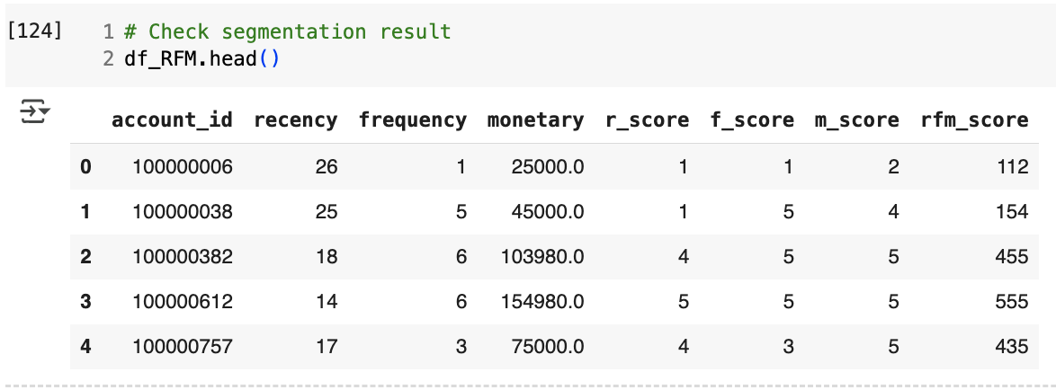
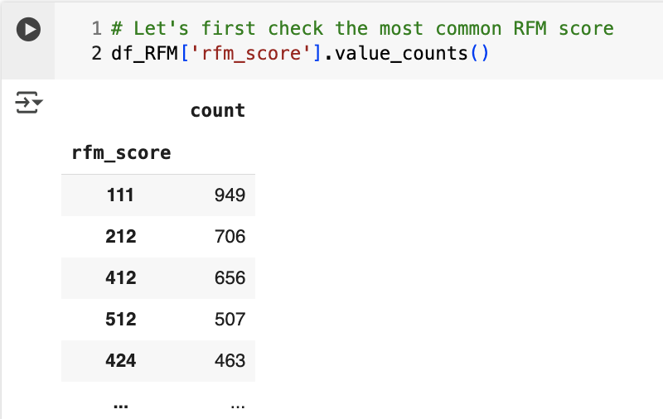
Create RFM Score
After we segment the features representing RFM, we create a score by combining the individual values of R, F, and M.
Code
Considering that 111 is the most common and worst score, we will interpret the data by mapping the RFM score into the following 11 predefined segments:
# Combine all score
df_RFM.loc[:, 'rfm_score'] = df_RFM['r_score']. astype(str) + df_RFM['f_score'].astype(str) + df_RFM ['m_score']. astype(str)
# Check segmentation result
df_RFM.head()
# Let's first check the most common RFM score
df_RFM['rfm_score'].value_counts()
# Let's first check the most common RFM score
df_RFM['rfm_score'].value_counts()
Segment | Description | Actionable
Champions | Used their credit card very recently, very frequently, and spent the most | Offer premium rewards, exclusive cashback, and early access to promos
Loyal Customers | Used their credit card recent, frequent usage and consistently high spending | Provide tailored loyalty programs, upgrade options, or VIP customer treatment
Potential Loyalist | Started using the card recently, with moderate spend and multiple uses | Encourage repeat usage with milestone bonuses or tiered rewards
Recent Customers | Just started or recently resumed usage, with low spend | Promote beginner offers, explain card features, and suggest spend categories
Promising | Recent activity but very low total spending | Recommend spending opportunities based on interests, and share targeted promos
Needs Attention | Spent moderately before but haven’t used the card in a while | Trigger gentle nudges with reminders of unused rewards or expiring offers
About To Sleep | Customers with declining activity and no recent usage | Send win-back campaigns with 0% installment plans or double point incentives
At Risk | High past usage and spending, but inactive for a long time | Reconnect with offers highlighting their past benefits and tailored incentives
Can’t Lose Them | Former loyal users who visited frequently before but are now inactive | Offer retention deals like waived fees, exclusive benefits, or bonus points
Hibernating | Inactive for a long period, with minimal historical engagement | Use simple reactivation messages and one-time offers to bring them back
Lost | Long-term inactivity with the lowest usage and engagement history | Optionally remove from campaigns or send survey to understand disengagement reason
Outout
More results on Google Colab Notebook
Notes:
By assigning scores (1-5) for each RFM metric based on these rules, you can then group customers into different segments (e.g., "Best Customers," "Loyal Customers," "Churned Customers") to better understand their behavior and target them with relevant marketing campaigns.

Slide 45
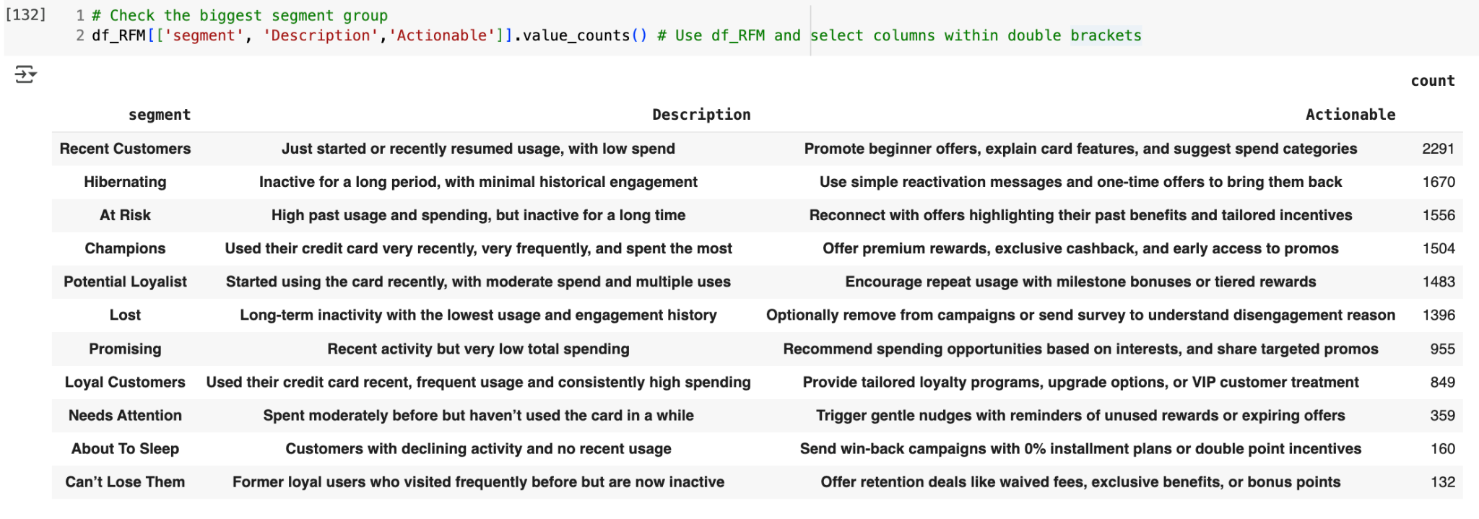
RFM Segmentation Result
After we determine the features that represent RFM, we begin segmentation using pd.qcut, where q = 5, which results in scores as follows:
Code
Outout
# Import DataFrame
GSHEET_URL = 'https://docs.google.com/spreadsheets/d/1AW-z4ljE-lyoelB80J_FclFxM-Zl44DW7by_y-3rU8Y/edit?usp=sharing'
GSHEET_URL_CSV = GSHEET_URL.replace('/edit?usp=sharing', '/export?format=csv')
rfm_segments = pd.read_csv (GSHEET_URL_CSV)
# Print the columns of the DataFrame to check the actual column names
print(rfm_segments.columns)
# Changing rfm_score datatype to str
rfm_segments.head()
rfm_segments['rfm_score'] = rfm_segments['rfm_score'].astype(str)
# Merge the score and the segment definition
df_RFM = pd.merge(
df_RFM,
rfm_segments,
how='left',
on='rfm_score'
)
# Check the biggest segment group
df_RFM[['segment', 'Description','Actionable']].value_counts() # Use df_RFM and select columns within double brackets
We have a significant number of recent customers, however, a substantial portion of our customer base is inactive or at risk of attrition. Our top 3 recommended actions are:
Launch a targeted campaign for new customers
Implement a reactivation strategy for inactive customers
Reconnect with high-value customers
More results on Google Colab Notebook
Notes:
By assigning scores (1-5) for each RFM metric based on these rules, you can then group customers into different segments (e.g., "Best Customers," "Loyal Customers," "Churned Customers") to better understand their behavior and target them with relevant marketing campaigns.

Slide 46
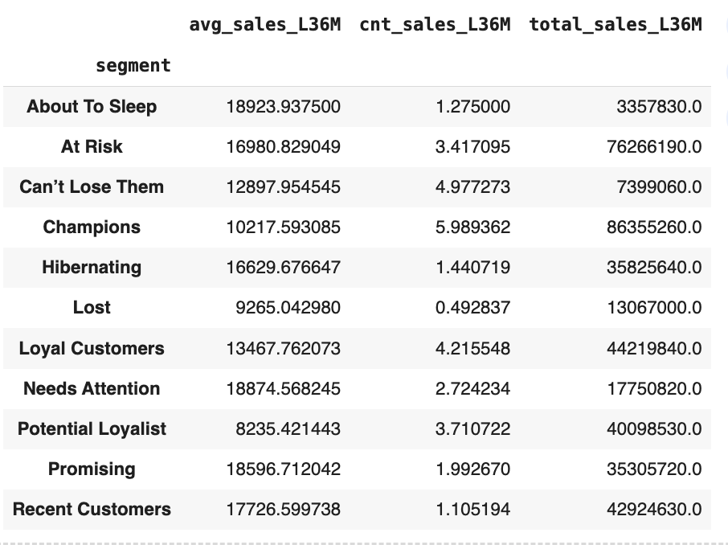
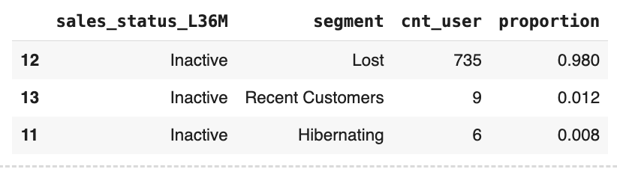
Segment Analysis
After we have assigned each client to a specific segment, we want to analyze and identify the segments that have higher average sales per client, higher average transaction frequency (count of sales) per client, higher revenue generated, and/or a larger proportion of clients with no sales.
Code
Outout
#Identify the segments that have higher average sales per client, higher average transaction frequency (count of sales) per client, higher revenue generated, and/or a larger proportion of clients with no sales.
sales_per_segment = df2.groupby('segment').agg({
'avg_sales_L36M' : 'mean', # Pass column names as strings
'cnt_sales_L36M' : 'mean', # Pass column names as strings
'total_sales_L36M' : 'sum' # Pass column names as strings
})
sales_per_segment
# Group cnt_user by sales_status_L36M and segment
segment_activity = df2.groupby(['sales_status_L36M','segment'])['account_id'].count().reset_index().rename(columns={'account_id': 'cnt_user'})
segment_activity
# Filter only the segment that have no sales
segment_inactive = segment_activity[segment_activity['sales_status_L36M'] =='Inactive']
segment_inactive
# Create a proportion for segment that have no sales
segment_inactive['proportion'] = segment_inactive['cnt_user']/segment_inactive['cnt_user'].sum()
segment_inactive
# Sort
segment_inactive = segment_inactive.sort_values('proportion', ascending=False)
# Display the sorted proportions
segment_inactive
More results on Google Colab Notebook
Notes:
By assigning scores (1-5) for each RFM metric based on these rules, you can then group customers into different segments (e.g., "Best Customers," "Loyal Customers," "Churned Customers") to better understand their behavior and target them with relevant marketing campaigns.

Slide 47
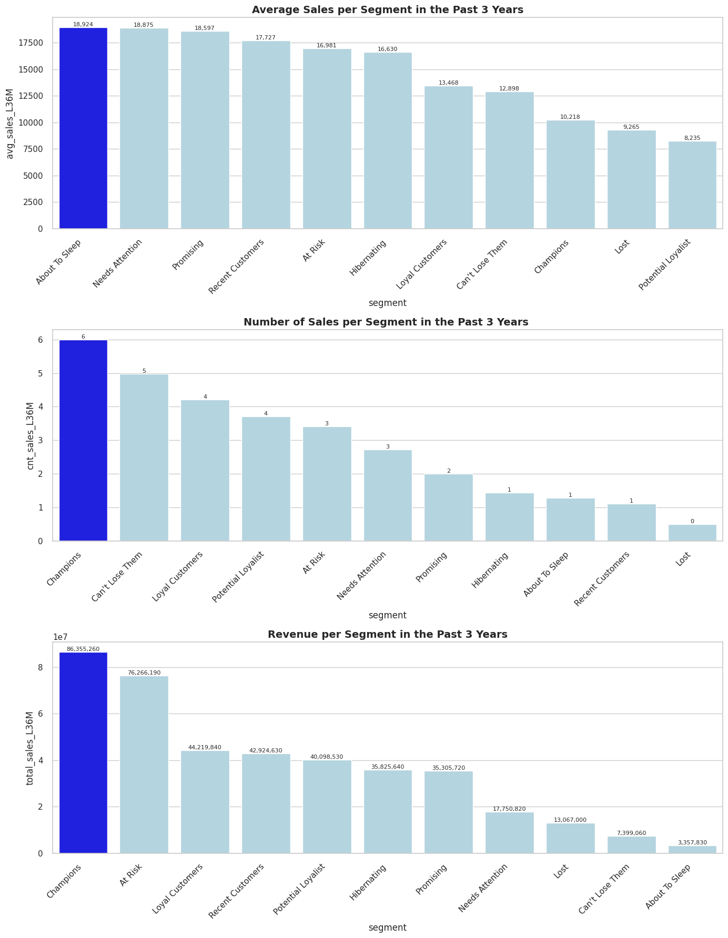
Average Sales per Segment in the Past 3 Years
The 'about to sleep' segment exhibits the highest average sales per client at 18,924 euros compared to other segments, despite consisting of customers with declining activity and no recent usage. This indicates that some customers in this segment might have made a few large purchases but not recently. This suggests that this segment still holds significant potential. One potential action to engage these customers is to implement win-back campaigns that offer incentives such as 0% installment plans or double reward points.
More results on Google Colab Notebook
Notes:
By assigning scores (1-5) for each RFM metric based on these rules, you can then group customers into different segments (e.g., "Best Customers," "Loyal Customers," "Churned Customers") to better understand their behavior and target them with relevant marketing campaigns.

Slide 48
Number of Sales per Segment in the Past 3 Years
The 'Champions' segment has the highest average number of sales per client at 6, surpassing all other segments. This segment comprises users who have used their credit cards very recently, very frequently, and have spent the most. To maintain their engagement, we can offer premium rewards, exclusive cashback, and early access to promotions.
More results on Google Colab Notebook
Notes:
By assigning scores (1-5) for each RFM metric based on these rules, you can then group customers into different segments (e.g., "Best Customers," "Loyal Customers," "Churned Customers") to better understand their behavior and target them with relevant marketing campaigns.

Slide 49
Revenue per Segment in the Past 3 Years
The 'Champions' segment contributes the largest revenue in the past 3 years, amounting to 86,355,260 euros, exceeding all other segments. This segment is composed of users who have used their credit cards very recently, very frequently, and have spent the most. To maintain their engagement and loyalty, we can offer premium rewards, exclusive cashback, and early access to promotions.
More results on Google Colab Notebook
Notes:
By assigning scores (1-5) for each RFM metric based on these rules, you can then group customers into different segments (e.g., "Best Customers," "Loyal Customers," "Churned Customers") to better understand their behavior and target them with relevant marketing campaigns.

Slide 50
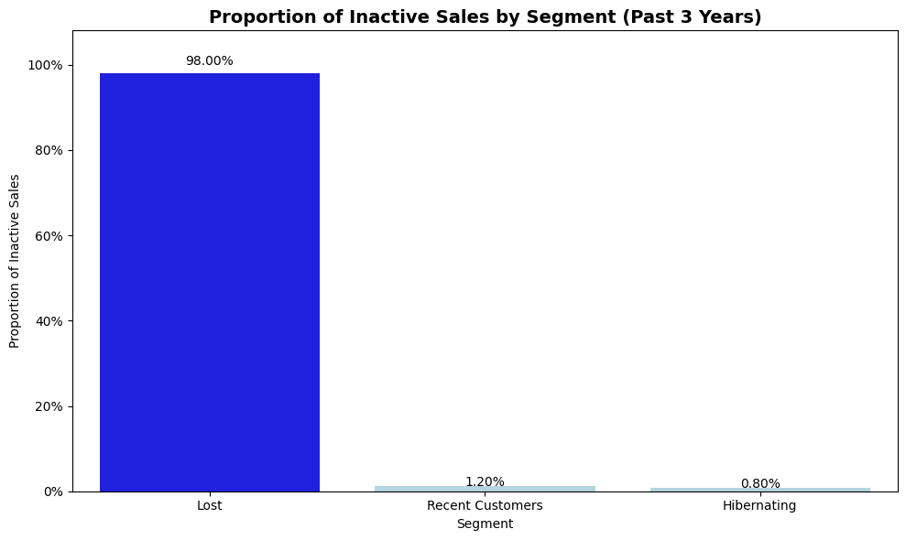
Proportion of Inactive Sales in the Past 3 Years
There are 3 segments containing inactive customers who haven't made any purchases in the past three years. These segments are 'Lost,' 'Recent Customer,' and 'Hibernating.' The 'Lost' segment represents the largest proportion of inactive customers at 98%. This segment consists of customers exhibiting long-term inactivity and having the lowest usage and engagement history. To address this segment, we can optionally remove them from marketing campaigns or conduct surveys to understand the reasons behind their disengagement.
More results on Google Colab Notebook
Notes:
By assigning scores (1-5) for each RFM metric based on these rules, you can then group customers into different segments (e.g., "Best Customers," "Loyal Customers," "Churned Customers") to better understand their behavior and target them with relevant marketing campaigns.

Slide 51
User persona and Personalize Actionable Recommendation

Slide 52
User persona and Personalize Actionable Recommendation for each Segment
User Persona | Description | Actionable Recommendation | Number of User
Recent Customers | Just started or recently resumed usage, with low spend | Promote beginner offers, explain card features, and suggest spend categories | 2291
Hibernating | Inactive for a long period, with minimal historical engagement | Use simple reactivation messages and one-time offers to bring them back | 1670
At Risk | High past usage and spending, but inactive for a long time | Reconnect with offers highlighting their past benefits and tailored incentives | 1556
Champions | Used their credit card very recently, very frequently, and spent the most | Offer premium rewards, exclusive cashback, and early access to promos | 1504
Potential Loyalist | Started using the card recently, with moderate spend and multiple uses | Encourage repeat usage with milestone bonuses or tiered rewards | 1483
Lost | Long-term inactivity with the lowest usage and engagement history | Optionally remove from campaigns or send survey to understand disengagement reason | 1396
Promising | Recent activity but very low total spending | Recommend spending opportunities based on interests, and share targeted promos | 955
Loyal Customers | Used their credit card recent, frequent usage and consistently high spending | Provide tailored loyalty programs, upgrade options, or VIP customer treatment | 849
Needs Attention | Spent moderately before but haven’t used the card in a while | Trigger gentle nudges with reminders of unused rewards or expiring offers | 359
About To Sleep | Customers with declining activity and no recent usage | Send win-back campaigns with 0% installment plans or double point incentives | 160
Can’t Lose Them | Former loyal users who visited frequently before but are now inactive | Offer retention deals like waived fees, exclusive benefits, or bonus points | 132
We have a significant number of recent customers, however, a substantial portion of our customer base is inactive or at risk of attrition. Our top 3 recommended actions are:
Launch a targeted campaign for new customers: This campaign will focus on providing personalized recommendations for spending categories based on their individual preferences and needs. This can lead to higher engagement and usage of our credit cards.
Implement a reactivation strategy for inactive customers: This strategy will involve sending a concise and engaging reactivation message coupled with a compelling, limited-time offer to encourage customers to resume using their RevoBank credit cards. This can help revive inactive accounts and drive increased transactions.
Reconnect with high-value customers: We should proactively reach out to high-past usage and spending customers with exclusive offers highlighting the benefits they have previously enjoyed and offering tailored incentives to recognize their loyalty. This can reinforce relationships with valuable customers and motivate them to maintain or increase their spending patterns.
More results on Google Colab Notebook
Notes:
By assigning scores (1-5) for each RFM metric based on these rules, you can then group customers into different segments (e.g., "Best Customers," "Loyal Customers," "Churned Customers") to better understand their behavior and target them with relevant marketing campaigns.

Slide 53

Thank you

